Slide 1
The A.R.T. of Marketing

Slide 2
Disclaimer
Some of the illustrations and photos of logos and brands are out of date
But the concepts included in this presentation are relevant and may help your squadron with developing or improving its marketing activities

Slide 3
ART:
The expression or application of human creative skill and imagination

Slide 4
A.R.T.
Attract, Recruit, and Transition
steps that comprise the art
of building your squadron

Slide 5
A - Attract
Attract the attention of potential members with more than just boating class flyers.
We get many members via public
boating classes, but there are other
ways to capture the public’s interest.

Slide 6
Class Exercise
List the many ways we can be visible to the public that are not related to ABC classes.
People need to see something multiple times before they react to it.

Slide 7
Web Sites
It’s 2016 – If you don’t have a web site, you don’t exist.
Is it up to date?
A standardized web site template is currently available for squadrons to use. It will be updated for America’s Boating Club® automatically.
It fills in class information from HQ800.

Slide 8
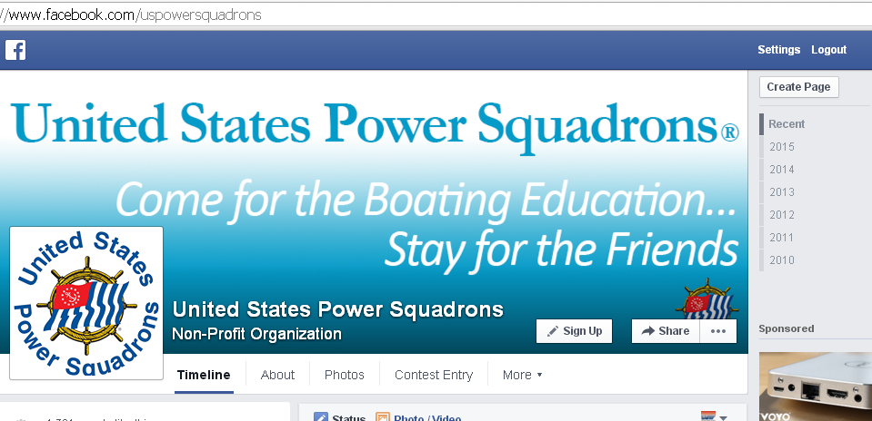
Social Media
As important today as web sites. (Facebook)
Is it active?

Slide 9
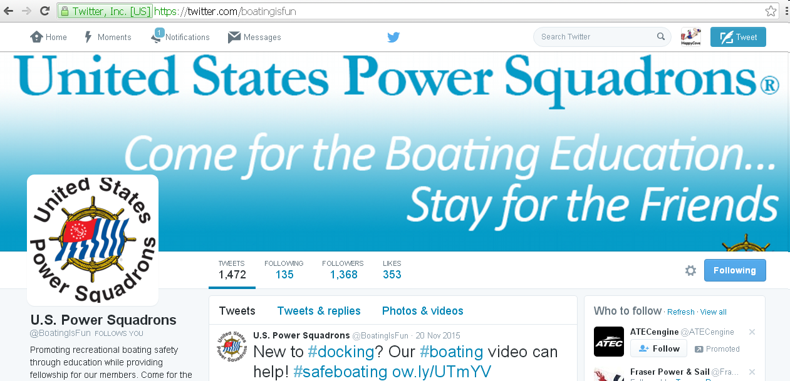
Social Media
As important today as web sites. (Twitter)
Is it active?
Share the effort:
Assign 1 day each Month for
Bridge Members
Committee Chairs
and Others

Slide 10
A Web Presence
I heard these guys talking about
Peconic Bay Power Squadron.
I looked them up, but
I don’t see anything.
Oh well
What’s that?
Why do you need it?
You must have heard wrong.

Slide 11
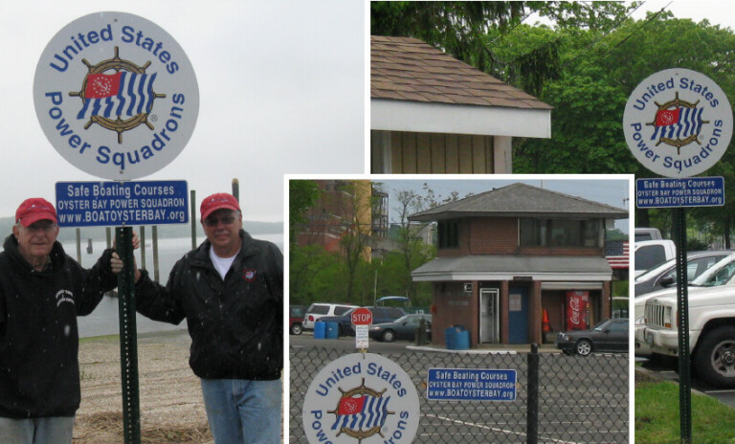
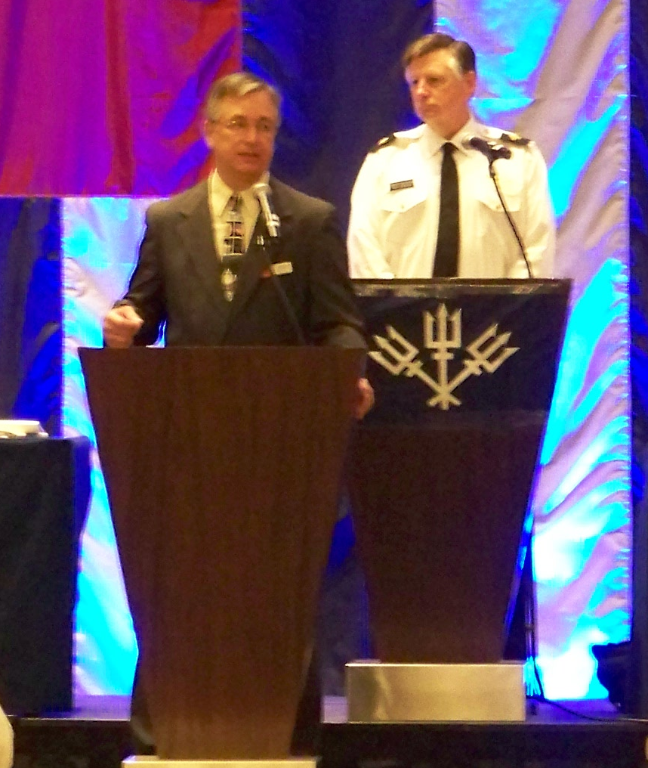
Service Club Signs
Low cost and will last for years. (Various Locations)

Slide 12
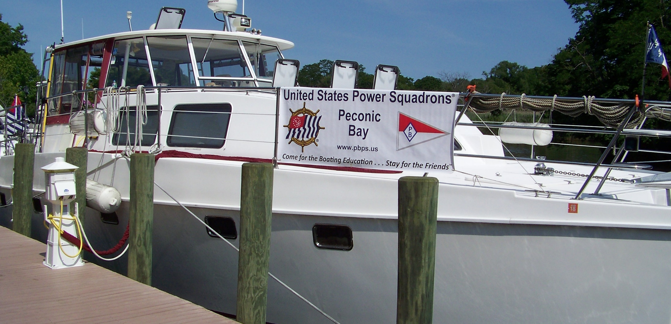
Banners (not just for boat shows)
Low cost and will last for years. (Town Dock)

Slide 13
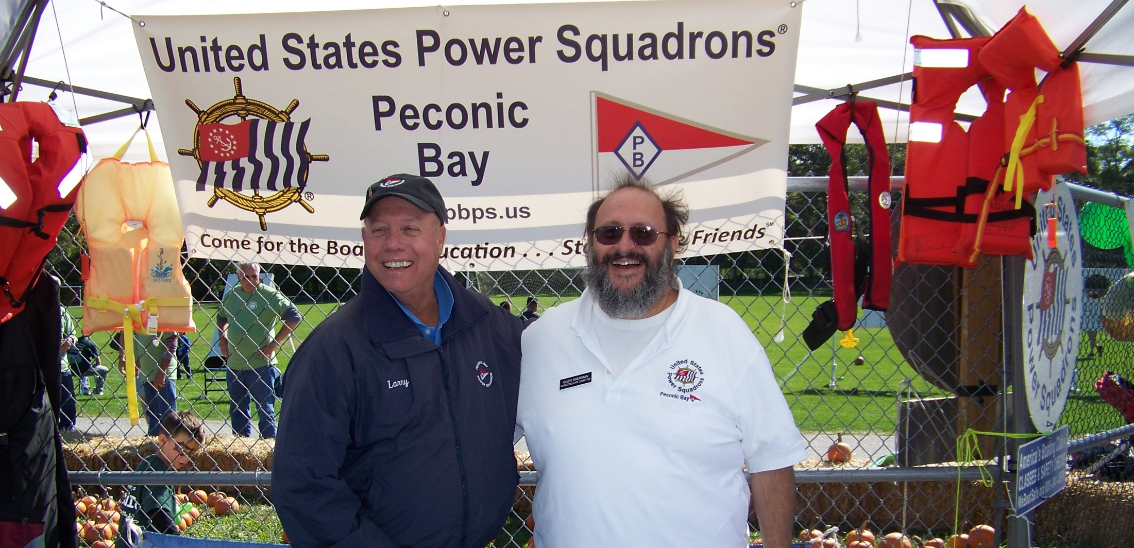
Banners
Work at Boat Shows and Public Events (Charity Event)

Slide 14
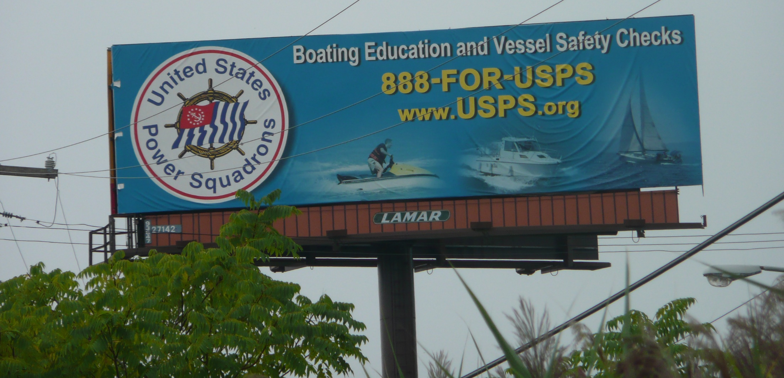
Even Bigger Banners
No limit on size

Slide 15
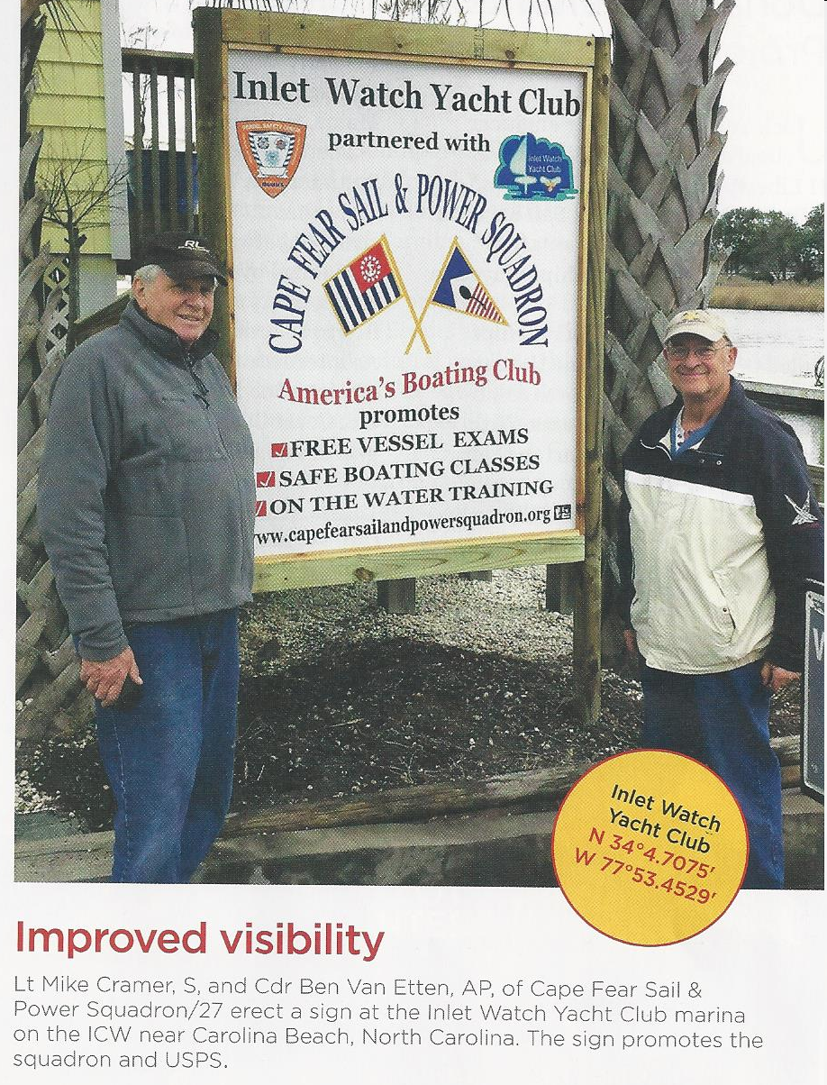
Partner Signs

Slide 16
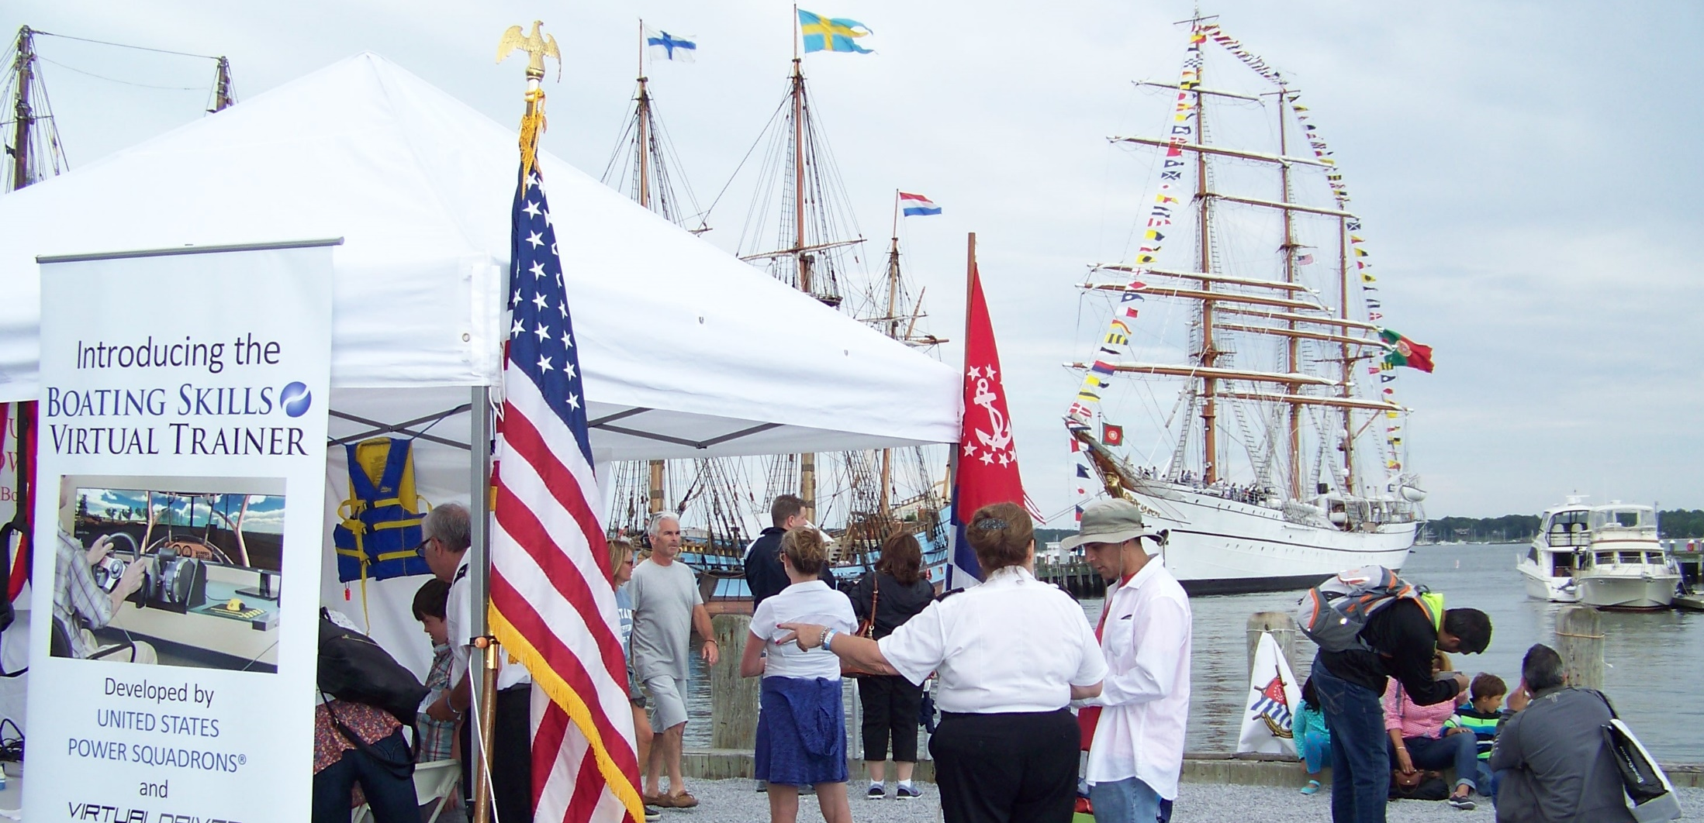
Virtual Trainer (Simulator)
Not just at traditional Boat Shows (Tall Ships)

Slide 17
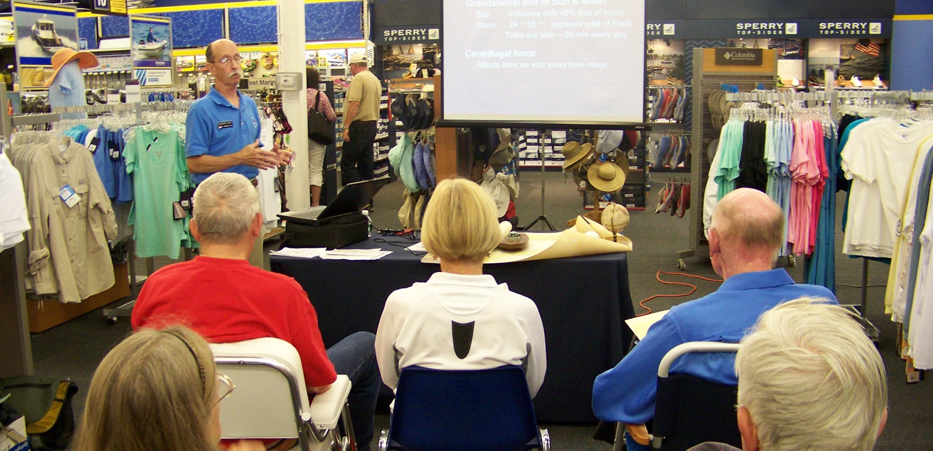
Seminars
Get out from behind closed doors. (i.e. West Marine)

Slide 18
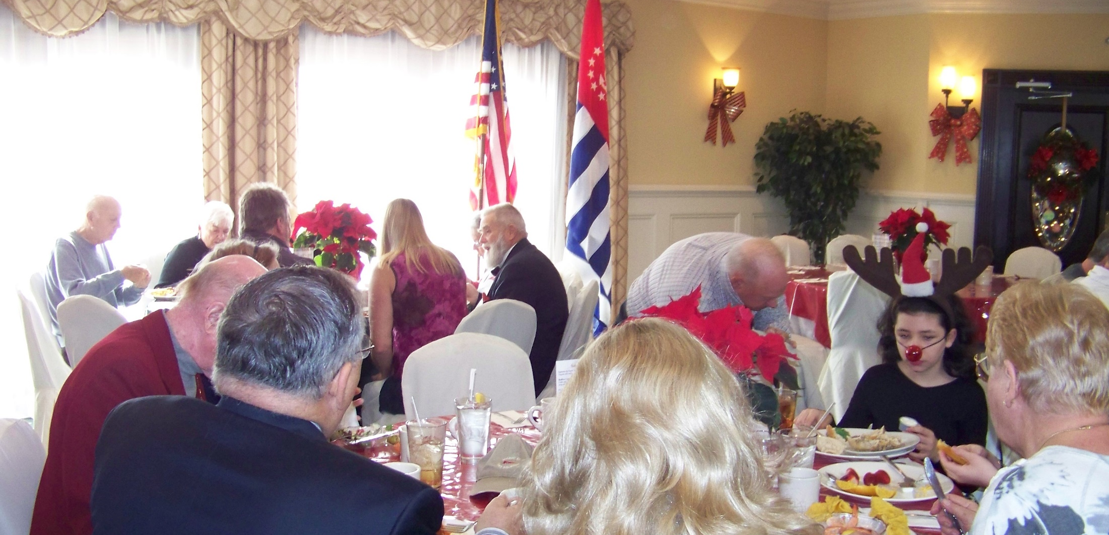
Dinners
Get out from behind closed doors. (Holiday Brunch)

Slide 19
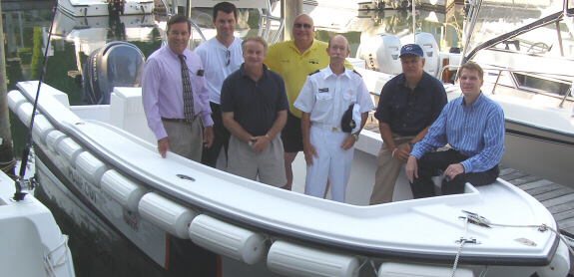
Photo Ops
Photo & story ran in the local papers.

Slide 20
Local Squadron Writers
Local boating magazine.

Slide 21
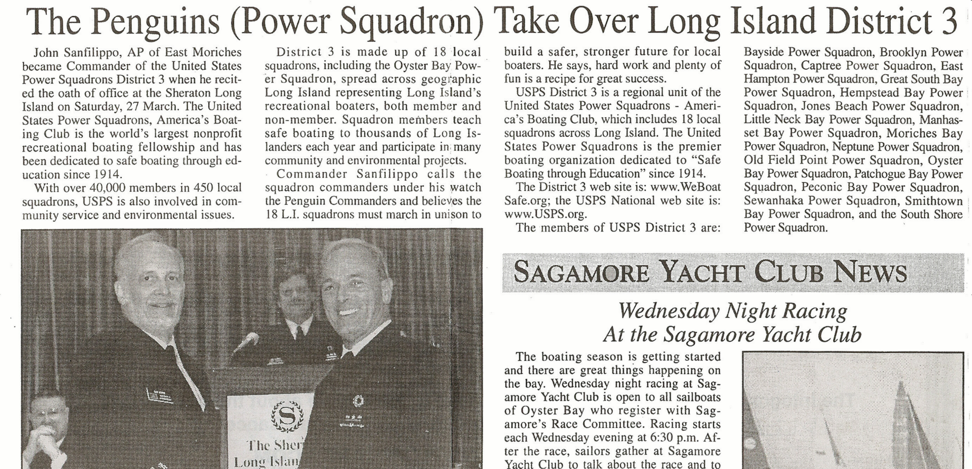
Press Releases
Write your own stories.

Slide 22
Networking
Have you:
Joined local community groups or councils?
Helped to staff local community events?
Offered your expertise to local government
when they have boating related issues?
Partnered with USCG, USCGA, constables,
and others for large events?

Slide 23
Networking
Have you:
Done a presentation about Power Squadron for Yacht Clubs
Town Councils
Community Groups
and others?
(A presentation is available to download.)

Slide 24
The Obvious
OK,
now you can include boat shows
and ABC class announcements & flyers.
Do all your promotional materials,
web site, social media offerings,
banners and other items have
a consistent look and feel that
follows branding standards.

Slide 25
Marketing
Marketing is not just 1 item like class flyers.
It’s a coordinated multi faceted approach where all the pieces must work together.
In the past squadrons did their own thing.
This approach was scattered as if we
were not all part of the same organization.

Slide 26
R - Recruit
Recruit those prospects and sign them up.
Will you Recruit directly to membership
or via America’s Boating Course?
If via ABC, do you have incentives or programs for Families, Retirees, or Others?
(Book share discounts, couple or group activities)

Slide 27
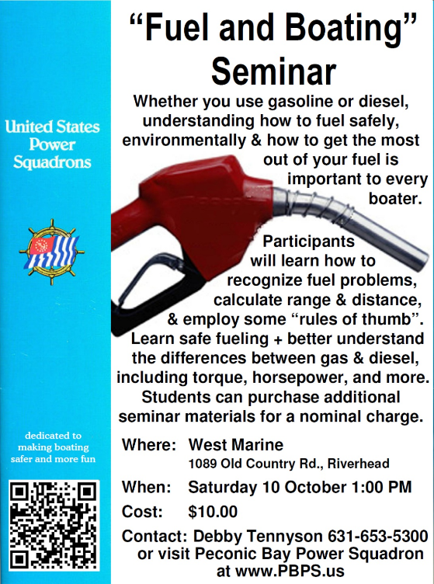
If via ABC:
Are you highlighting why ABC and other offerings are better than the competition?
Is the class listed
in local papers?
Have flyers
been posted?

Slide 28
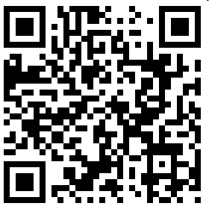
If via ABC:
Is the class announced on radio & TV?
Can your class be found on line?
Can they sign up and pay on line?

Slide 29
If via ABC:
Are you planting the seeds early
by offering ABC in public schools?

Slide 30
If via ABC:
Are you offering ABC to
Scout Troops or Fire Departments?

Slide 31
Recruit those prospects and sign them up.
You have their interest, now Recruit.
There are many ways to show how we are better, different, and worth joining.
They want to know:
What can you do for me?

Slide 32
Class Exercise
List the many reasons a prospective member would want to join us. Why are we better and what’s in it for them?
How can you close the deal?

Slide 33
Class Exercise
A new list:
What do they really want?
How do you address those wants?

Slide 34
Member Benefits
and Many More

Slide 35
Member Benefits
Do you:
Have a Member Benefits brochure
and keep it with your
other recruiting materials?
Know about any local Member Benefits?
(Local marina or parts supplier)

Slide 36
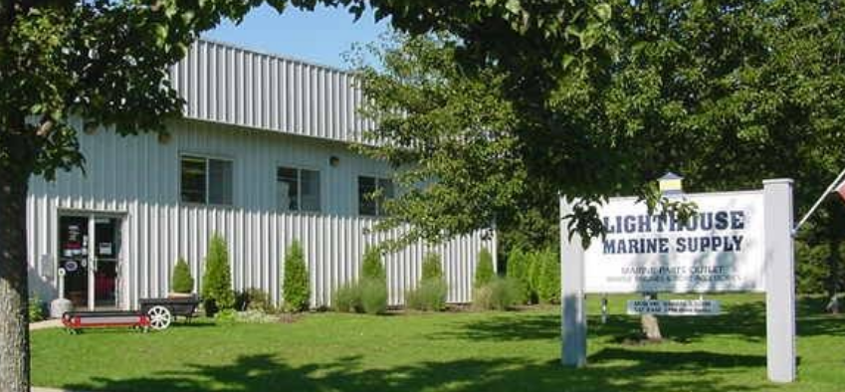
Lighthouse Marine Supply
marineengineparts.com partman.com

Slide 37
In Squadron Benefits
Education
Classes
Guest Speakers
Fraternal
Port Captains
Member Network
(Local & National)
Events

Slide 38
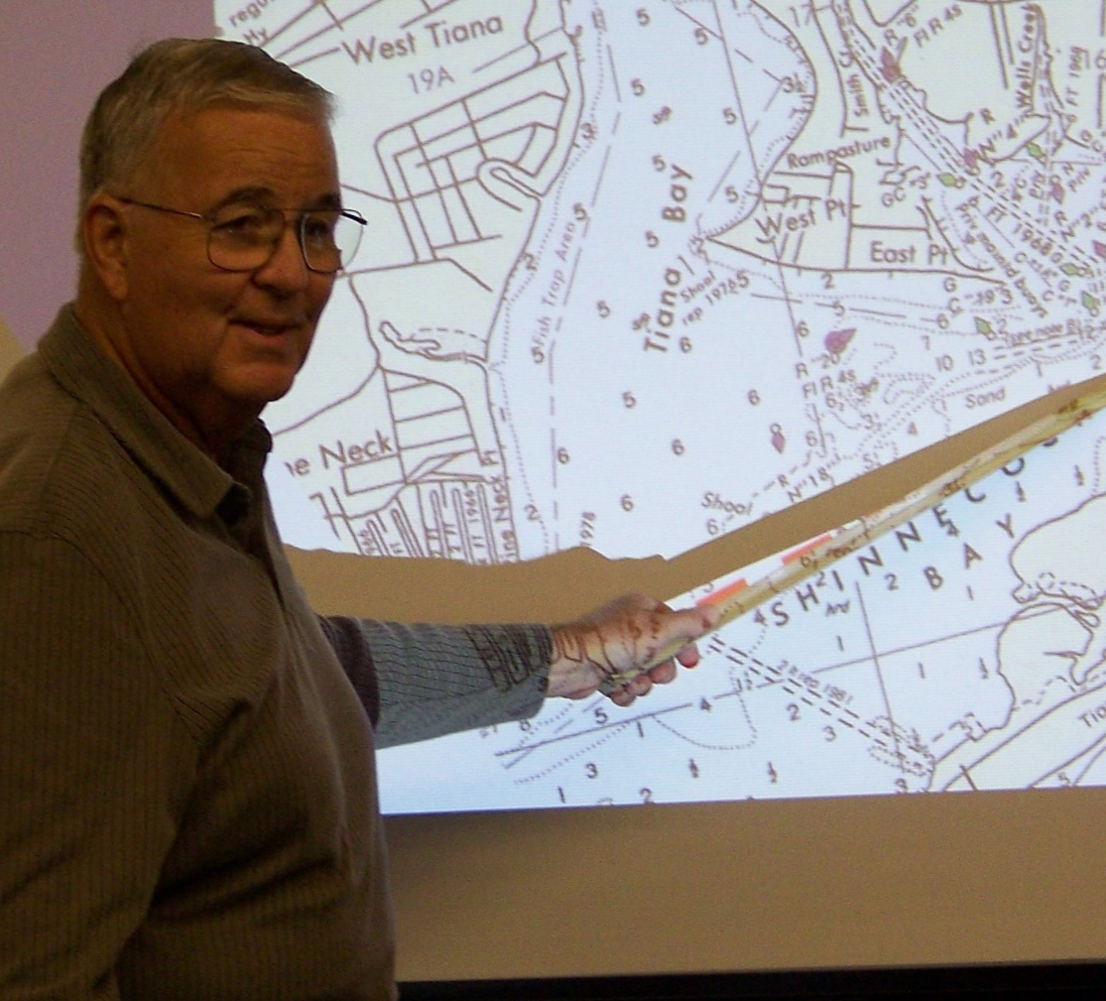
In Squadron Benefits
Education
Classes
Discounted to members
or
not available at all
to non-members

Slide 39
In Squadron Benefits
Seminars
Adv Grades
Operator Cert.
First Aid / CPR
Lecturers
and More
Education
Classes
Discounted to members
or
not available at all
to non-members

Slide 40
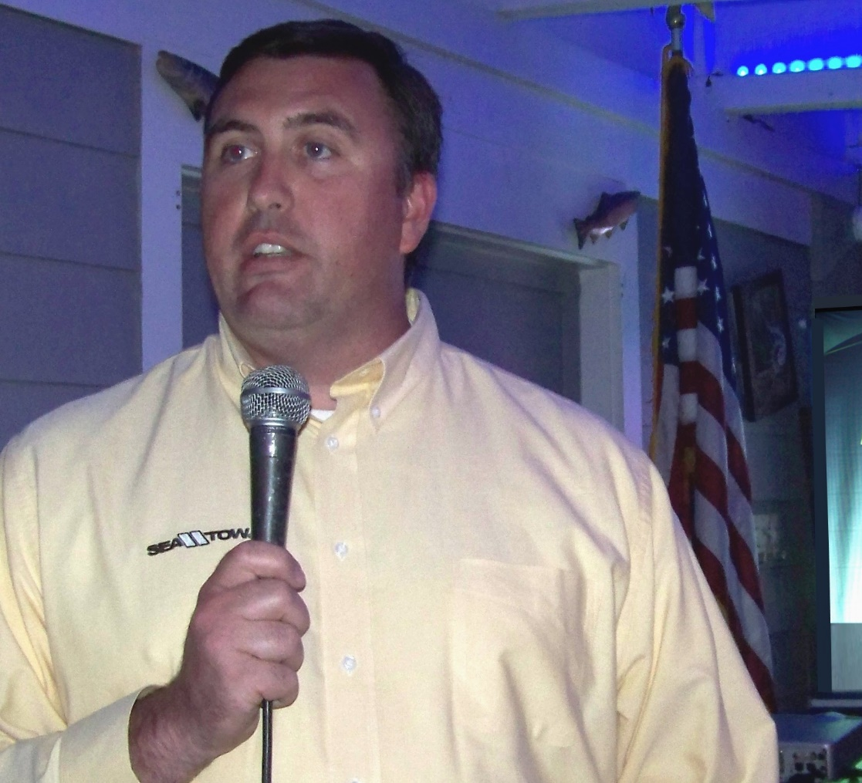
In Squadron Benefits
Education
Guest Speakers
Appear at meetings
and
not usually available
to the general public

Slide 41
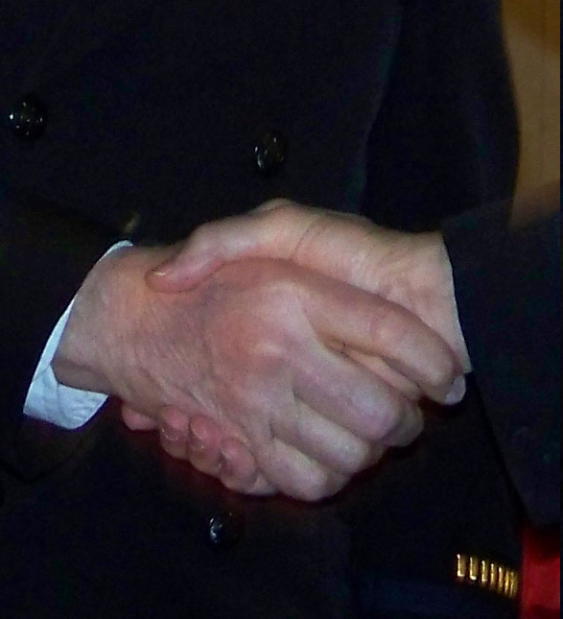
In Squadron Benefits
Fraternal
Port Captains
Member Network
(Local & National)
Events

Slide 42
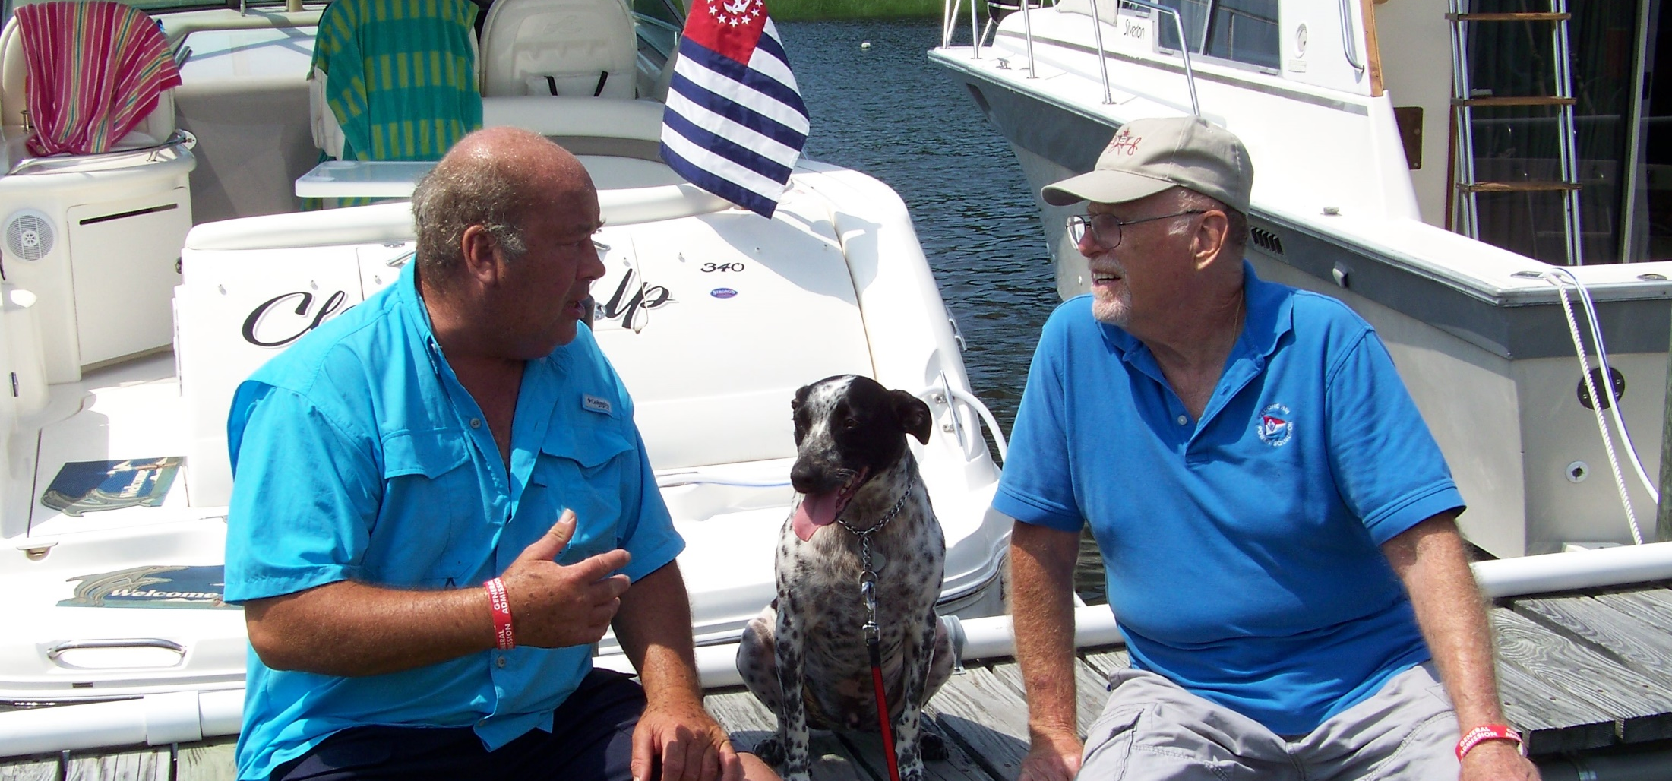
In Squadron Benefits
Local knowledge from fellow members

Slide 43
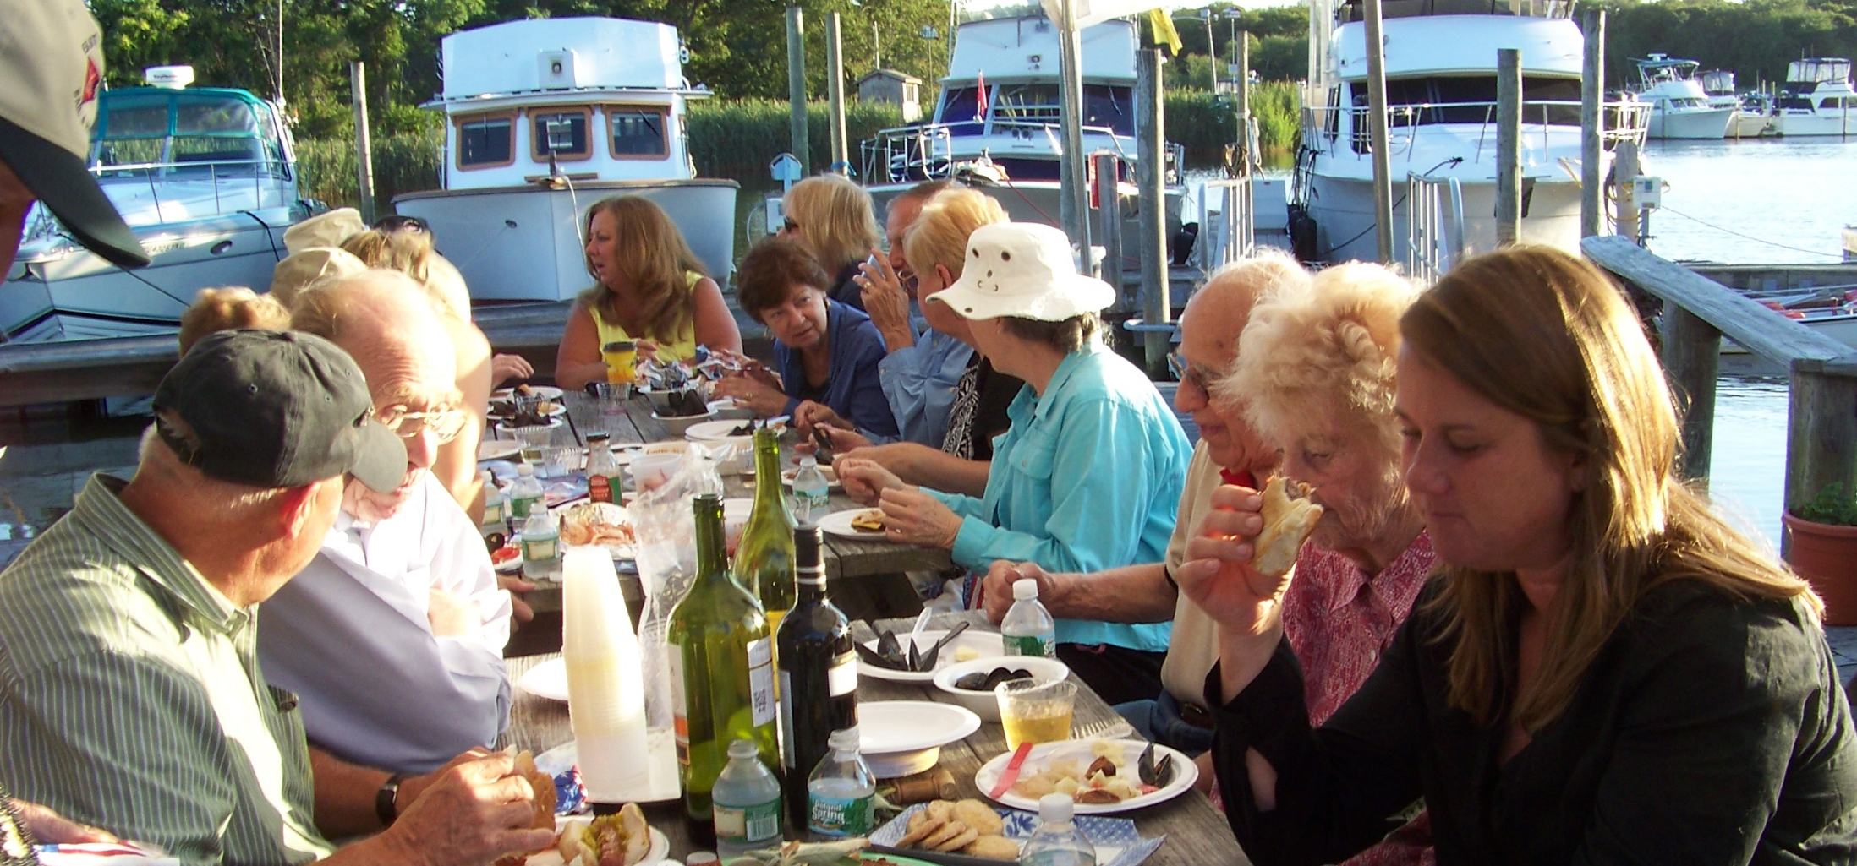
In Squadron Benefits
Casual gatherings with fellow members

Slide 44
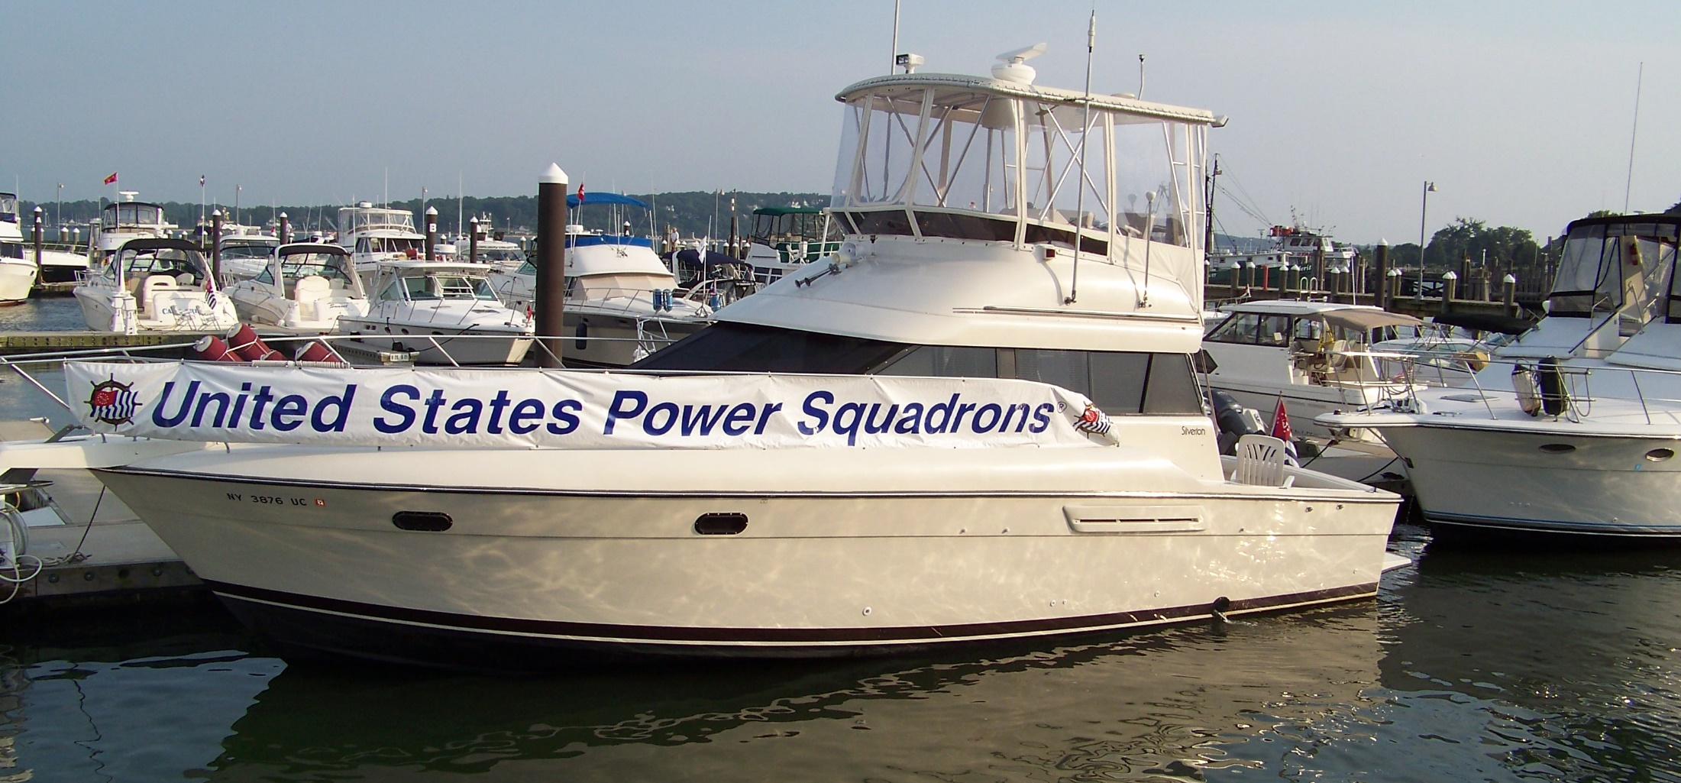
In Squadron Benefits
Fraternal Events – Rendezvous

Slide 45
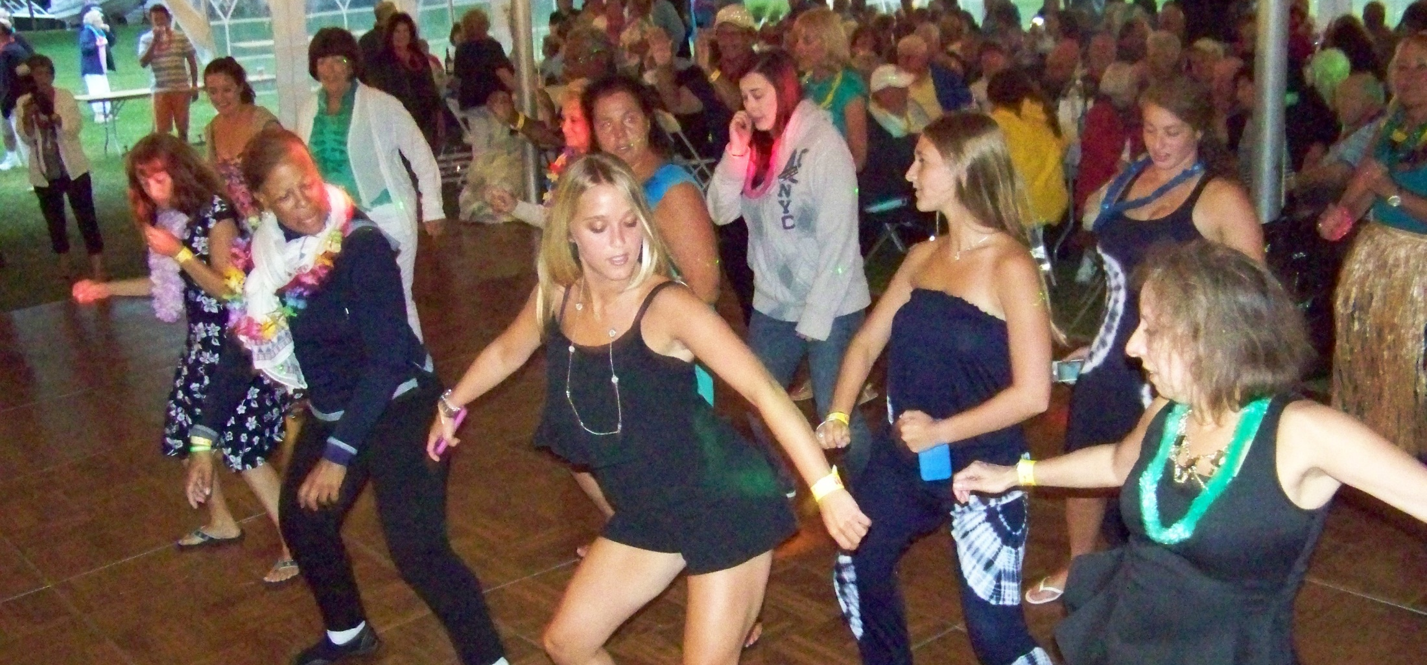
In Squadron Benefits
Fraternal Events – Rendezvous

Slide 46
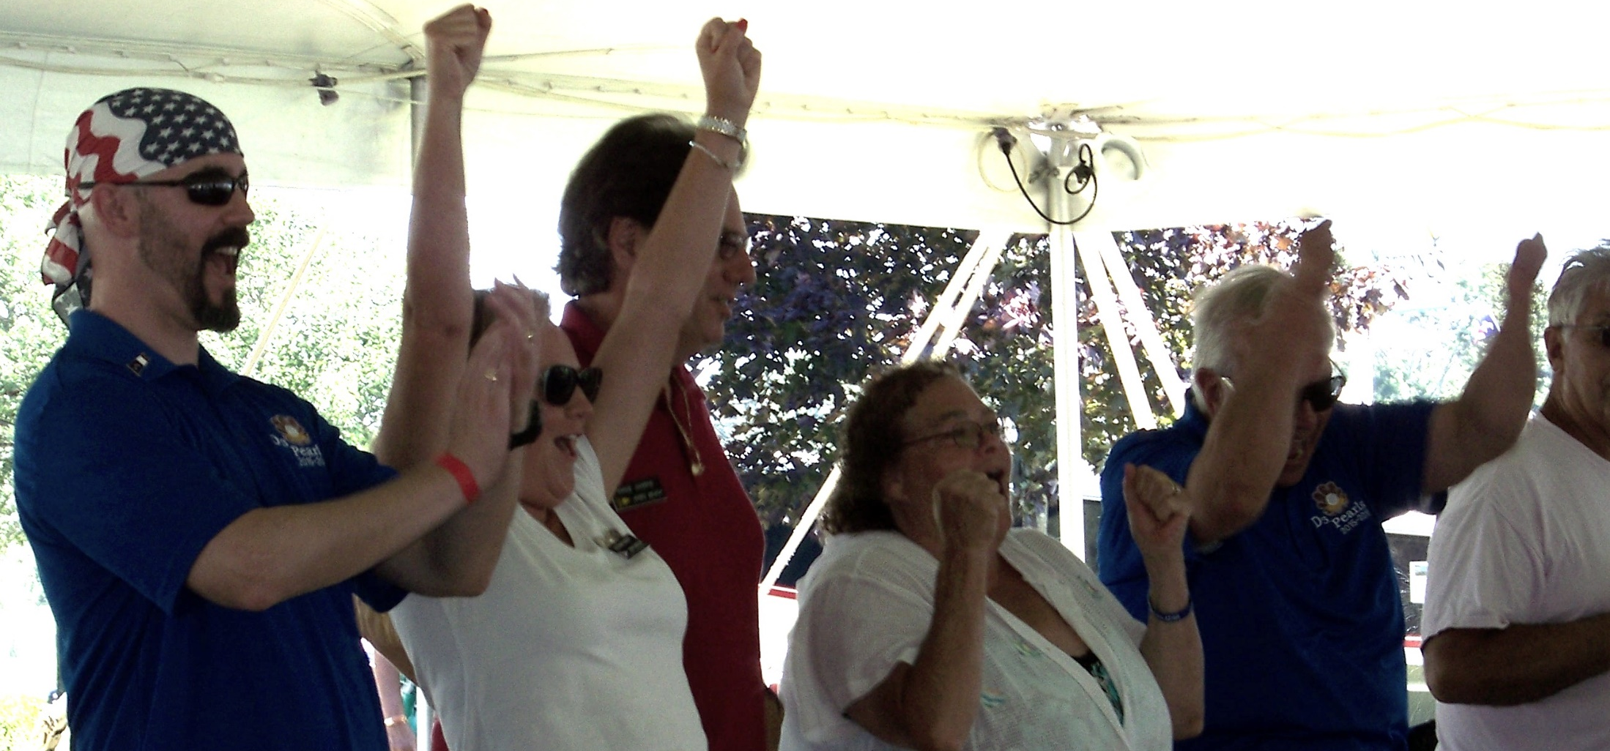
In Squadron Benefits
Fraternal Events – Fun & Games

Slide 47
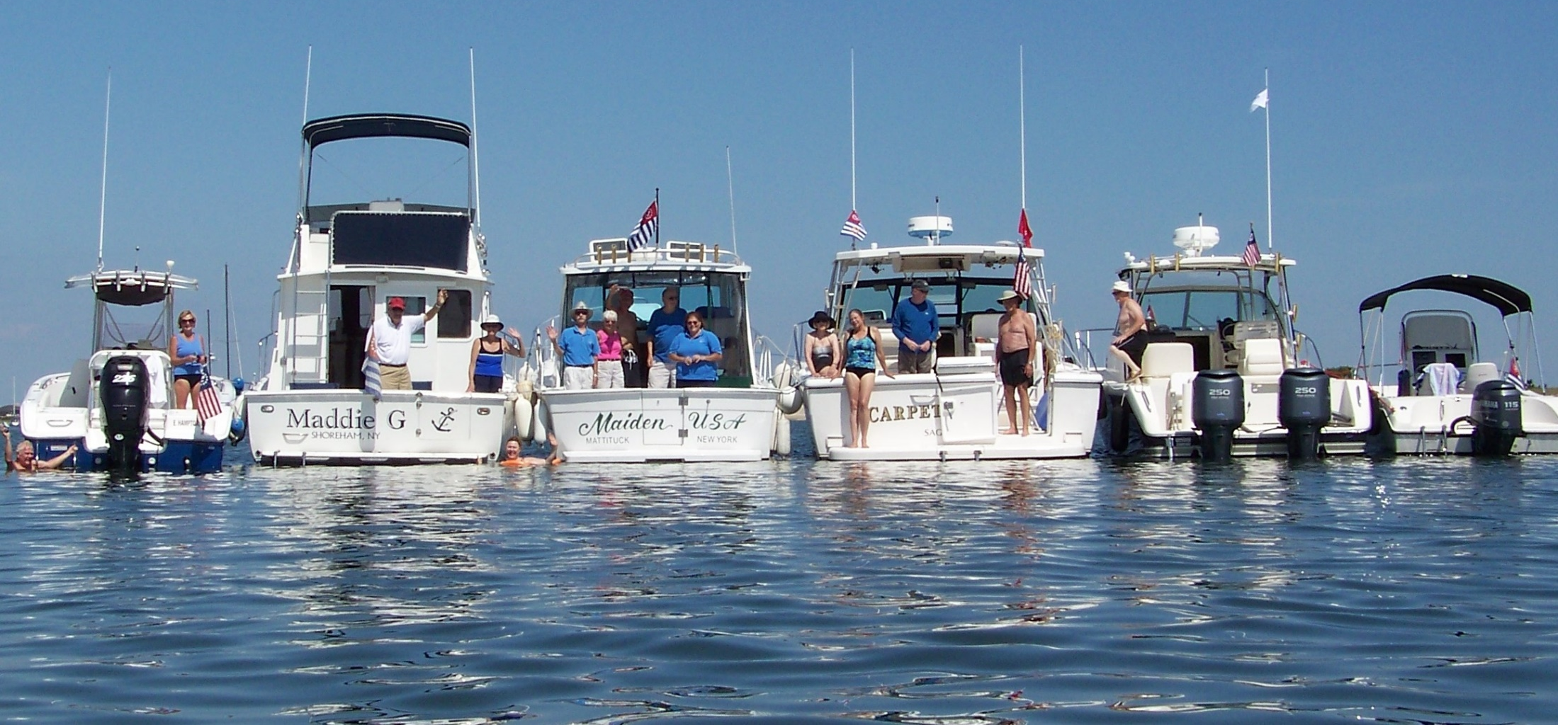
In Squadron Benefits
Fraternal Events – Raft Ups

Slide 48
Did you ask?
Are they interested
in doing community service?
(We do that)

Slide 49
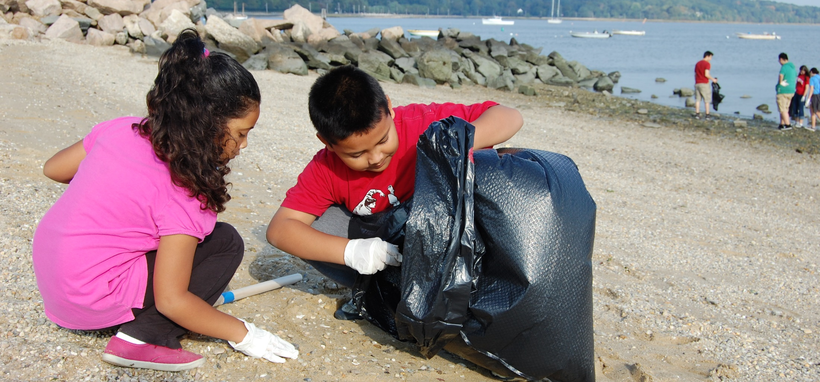
Community Service
Beach Clean Ups

Slide 50
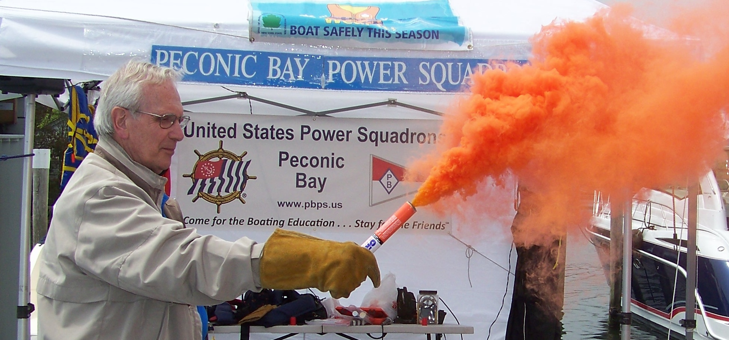
Community Service
Safety Demonstrations

Slide 51
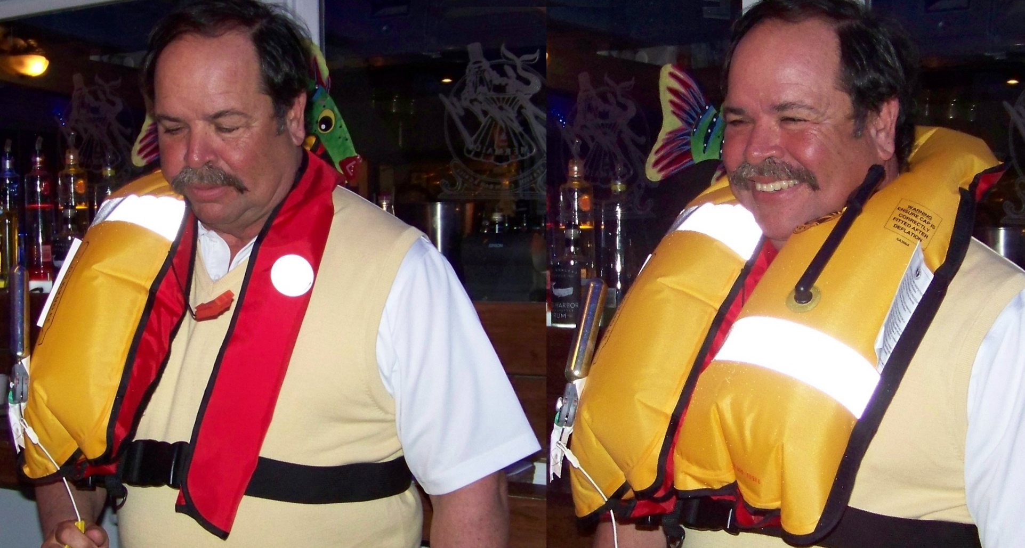
Community Service
Safety Demonstrations

Slide 52
Community Service
Safety Demonstrations

Slide 53
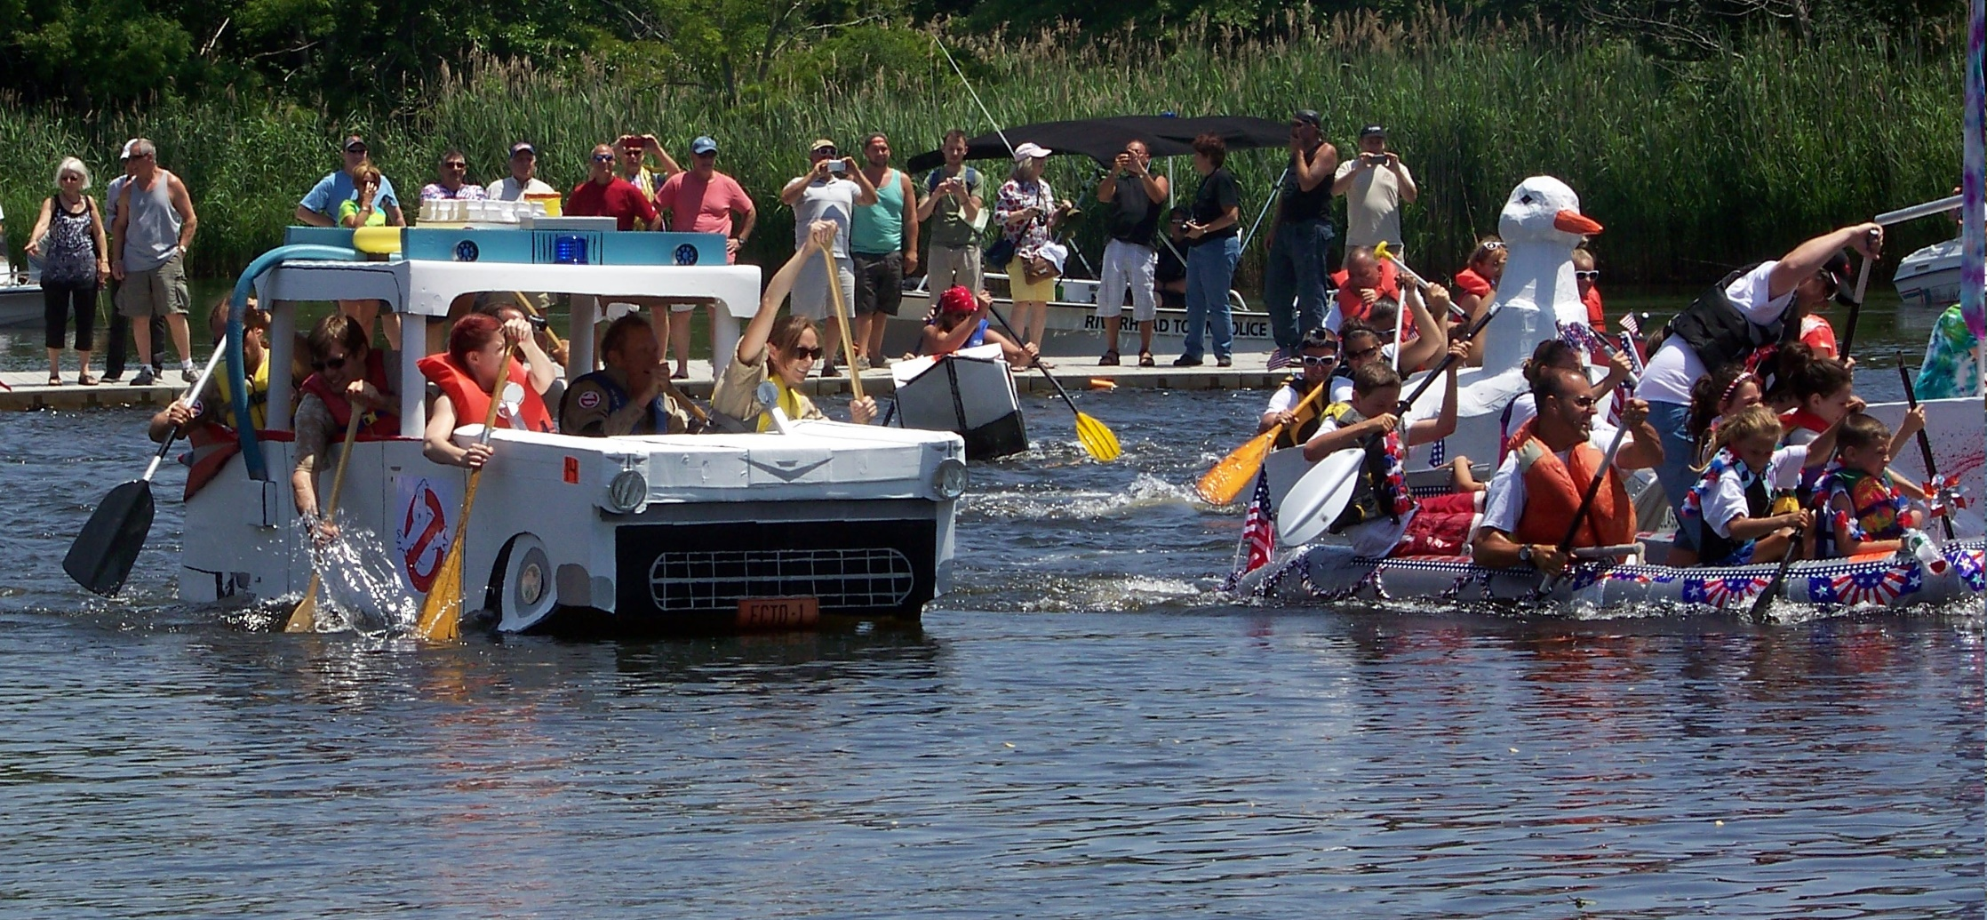
Community Service
i.e. Cardboard Boat Race
and Visibility
Squadron rescue boat and information booth

Slide 54
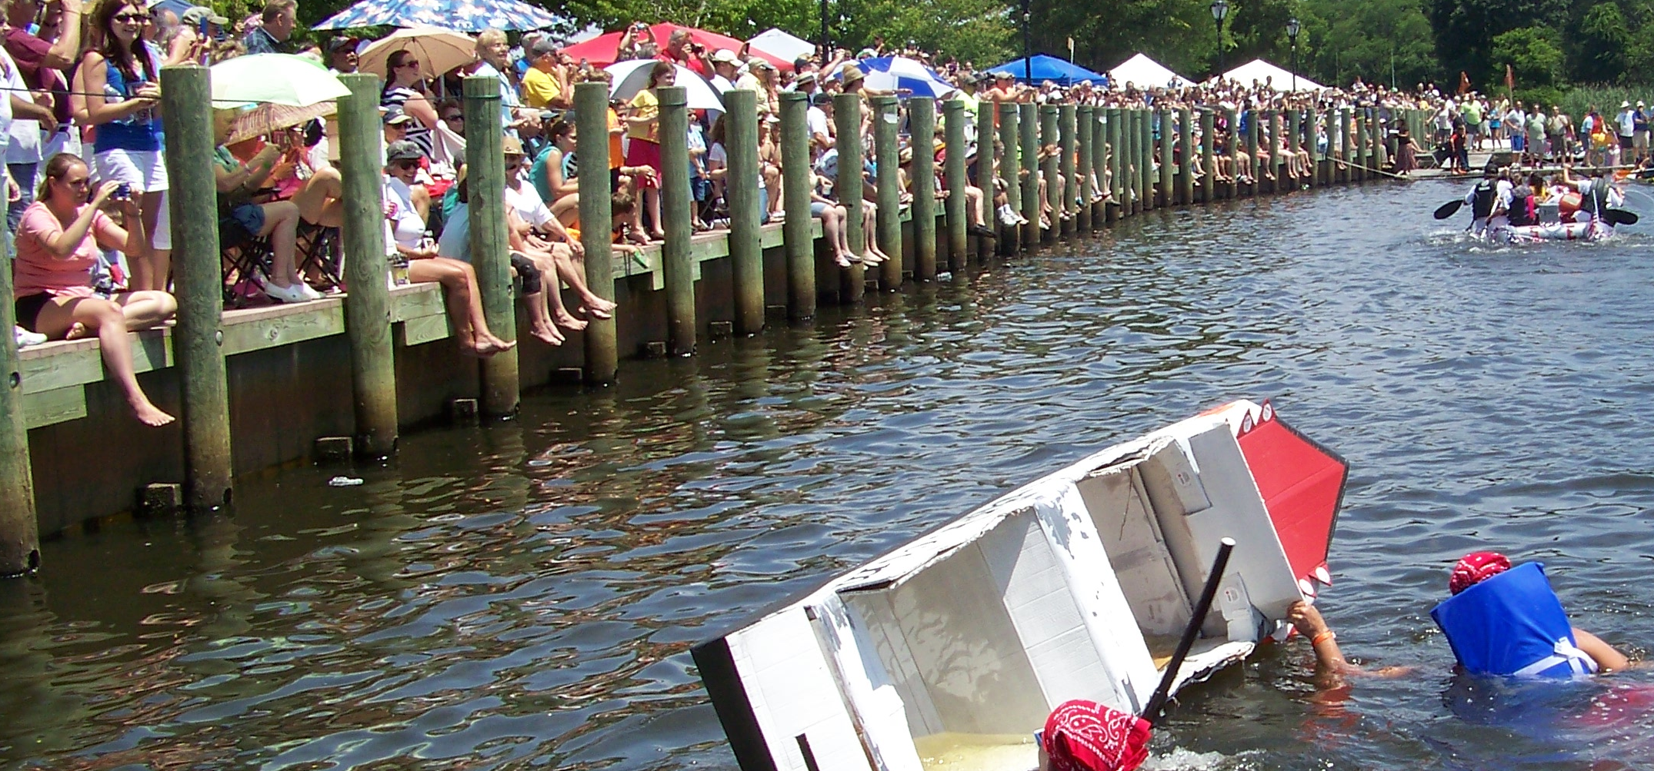
Community Service
i.e. Cardboard Boat Race
and Visibility
Help with a public event and be in front of all these people.

Slide 55
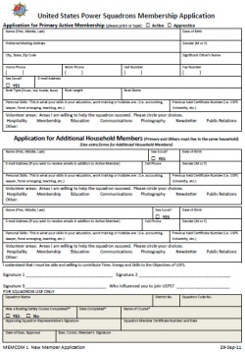
Missed Opportunities
Do you have:
A Promotional Trifold and Membership Application on your boat, in your car,
at home, at your office?
Squadron Business Cards
with your contact info?

Slide 56
Missed Opportunities
Can they:
Fill out or download an
Application on line?
Easily find your web site
or contact info

Slide 57
Missed Opportunities
Do you know:
When the next ABC Class is?
When the next General Meeting is?
Who will be the Guest Speaker?
The Membership Cost?

Slide 58
Missed Opportunities
Did you:
Get contact info so you can follow up?
Ask them if they have any questions?
Invite them to a meeting?
Invite them on your boat?

Slide 59
Missed Opportunities
Did you:
Calm their concerns about
“required” uniforms?
Tell them they can get the first
18 months for the price of 12?
(Get the 12 month payment up front.)

Slide 60
T - Transition
Transition them from new members
to lifelong members.
All members need a reason to stay and to stay involved… To be invested in the squadron.

Slide 61
Class Exercise
List the many ways we can encourage new members to become more involved and begin the transition to a lifelong member.

Slide 62
Did you:
Transition Cyber members to Squadrons (if that’s what they want)?
Assign all new members a mentor?
Invite them to a meeting or event?
(Offer to pick them up?)

Slide 63
Did you:
Welcome them?
Introduce them to other members within the Squadron and beyond?
Remind them that they belong to a large network of boaters?

Slide 64
Have you:
Included your new member in upcoming event planning?
Asked them for event ideas?
Included them as part of the team?
Asked how they want to get involved?

Slide 65
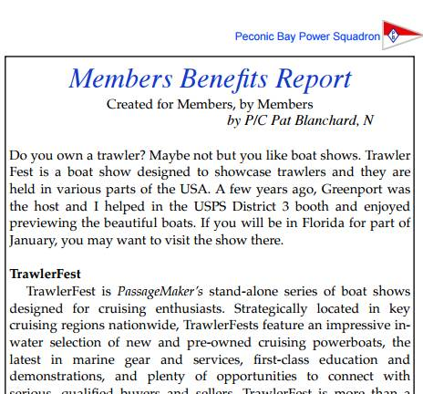
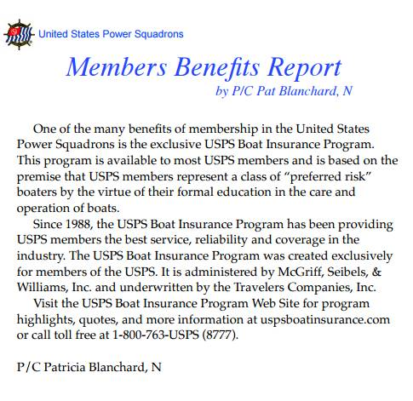
Do existing members need to be reminded of those Member Benefits?

Slide 66
Do existing members remember
the reasons they joined?
Education Social Gatherings Events
Member Knowledge Community Service
Have they been encouraged to participate and take advantage of these opportunities?

Slide 67
Do you know about B.A.R.S.?
Belonging….
Achievement
Recognition..
Status….......
BELONGING is easy, just pay your dues - but considering yourself a true member or volunteer requires ACHIEVING something for your organization, RECEIVING recognition by the organization, and finally achieving the STATUS that comes with being a recognized volunteer, committee chair, or officer.

Slide 68
Volunteers are not paid,
not because they are worthless,
but because they are priceless.
Recognize their achievements.

Slide 69
Summary:
Marketing, Public Relations, Education, Member Benefits, Membership, and others
must all work together as
one coordinated, harmonious, multifaceted unit to be successful.

