Slide 1

America’s Boating Course
3rd Edition
State & Local Regulations
Chapter 2
Section 8
DELAWARE
Notes:
Chapter 2 Section 8 State & Local Regulations
These slides are for DELAWARE. Make sure you know Delaware’s boating laws and regulations.
Obtain copies of Delaware’s Boating Regulations and give one to each student.

Slide 2

Legal Responsibility
United States Coast Guard
  Federal laws
  Equipment requirements
  Safety recommendations
Delaware Department of Natural Resources and Environmental Control
  Additional equipment requirements
  Educational requirements
  Registration
Notes:
Legal Responsibility
The U.S. Coast Guard is responsible for federal laws, equipment requirements and safety recommendations for recreational boats. Every state also has laws governing boating operations, additional equipment requirements, educational requirements and registrations. Each skipper is responsible for following these laws.
This would be a good time to discuss mandatory education laws, if they exist, for your states.

Slide 3
Registration
Registration required if boating on Delaware waters more than 60 days
State issues registration numbers
Decals are issued for calendar years and are valid for one or three years, option of owner
Out of state moves must be reported within 15 days
In state moves require registration within 15 days
Notes:
Title & Registering
Your state agency issues the initial Certificate of Registration. (Note: tell the students what agency in your state is responsible for this.)
The owner of a boat must notify the agency which issued the Certificate of Registration within 15 days:
If the boat is transferred, destroyed, abandoned, lost, stolen or recovered.
If the Certificate of Number is lost or destroyed or the owner’s address changes.
If the Certificate of Number becomes invalid for any reason.

Slide 4
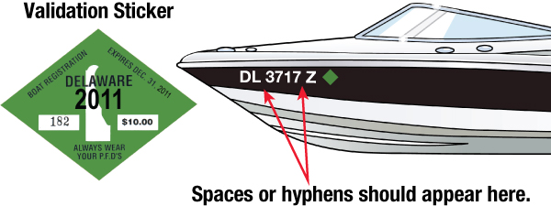
Registration
Display number and decals as follows:
Number must be painted, decaled or otherwise affixed to forward half of each side of vessel
Number must read from left to right
Number must be at least 3” high, bold, BLOCK letters

Slide 5
Registration
Number’s color must contrast with its background
Letters must be separated from numbers by spaces or hyphens
No other numbers may be displayed on either side of bow
Decals must be affixed on each side of the vessel
within 3 inches of the number

Slide 6
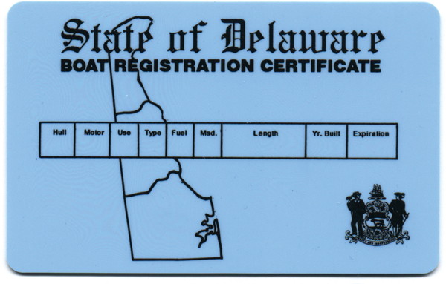
Registration
Registration Certificate
  Must be on board when underway
Issued by Delaware DNREC
Notes:
Registration
The Registration Certificate must be onboard while the vessel is underway and it must be available for inspection if requested by a law enforcement officer.
No other numbers can be affixed to the hull forward of amidships.

Slide 7

U.S. Documented Vessels
U.S. Citizens only may have a large vessel documented (at least 5 gross tons)
Documentation number must be permanent and clearly visible on the interior structure
Notes:
Documented Vessels
Other facts about titling your boat or PWC that you should know include Certificates of Documentation. A recreational boat, five or more net tons, owned by a U.S. citizen may, at the option of the owner, may apply for a U.S. Coast Guard Certificate of Documentation.
Documented Vessels:
Must have the vessel name and hailing port plainly marked on the exterior part of the hull in clearly visible letters not less than 4” in height.
The Official Number must be permanently affixed in block type letters not less than 3” in height on some clearly visible interior structural part of the boat.
Must be at least 5 Net Tons. This refers to the cargo capacity, not the vessel weight.
The Certificate of Documentation must be on the boat at all times.

Slide 8
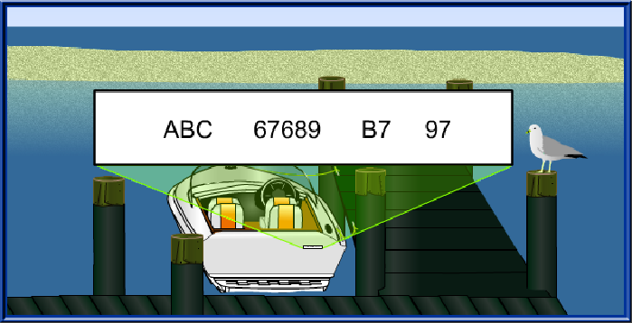
Hull Identification Numbers (HIN)
HIN unique number
Engraved into transom fiberglass
Notes:
Hull Identification Numbers
The Hull Identification Number (HIN) is a unique number assigned b the manufacturer to boats built after 1972. They identify one boat from another and are permanently engraved into the fiberglass or are on a metal plate attached to the transom.
Here is how to decode a HIN:
ABC – Manufacturer’s code.
67689 – Hull serial number.
B7 – Date of manufacturer – B is the code for February and 7 is the last digit of the year of manufacture.
97 – Model year.

Slide 9
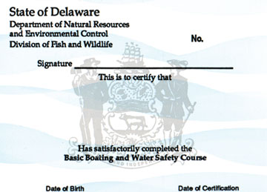
Who May Operate A Vessel
All persons born after January 1, 1978 must have in their possession a certificate of boating safety education to legally operate a numbered or documented vessel (including PWC) on Delaware’s public waters

Slide 10
Who May Operate A Vessel
Certificate obtained by successfully completing boating safety course or passing equivalency exam approved by Delaware DNREC
Persons required to have certificate must have it on board and available for inspection by an enforcement officer whenever operating a vessel on Delaware waters

Slide 11
Who May Operate A Vessel
No one under 14 may legally operate a PWC, even if they possess a certificate of boating safety education (14 and 15 year olds may operate if under supervision of parents).

Slide 12
Boat Rentals
Applies to boaters born after 1 Jan 1978
Renter must read and understand DNREC’s Boating rules and regulations
PWC rental: renter must be over 16 and have a certificate (if born after 1 Jan 1978) (14 or 15 years of age if under parental supervision)

Slide 13

Negligent Operation
Operating in restricted areas
Wake jumping, hull leaves water
Failure to regulate speed
Operating while under the influence of drugs or alcohol
Notes:
Beware of Negligent Operation
Negligent or reckless operation of a boat or PWC is prohibited by law. Reckless operation includes operation of a boat or PWC or use of a device being towed behind a boat or PWC. Reckless operation is defined as the failure to exercise the care necessary to prevent the endangerment of life, limb or property of any other person. Some examples of negligent operation include:
Operating in restricted waters without regard for other boaters or persons in the water.
Wake jumping where the hull leaves the water.
Failure to operate at a safe speed.
Operating under the influence of drugs or alcohol.
Hazardous water skiing practices.
Operating a boat in a swimming area.
Allowing passengers to ride on the bow, gunwale, transom, seat backs, seats on raised decks or any other place where there is a chance of falling overboard.
The U.S. Coast Guard may impose a civil penalty for negligent operation. Grossly negligent operation is a criminal offense and an operator may be fined up to $5000, imprisoned for a year, or both.

Slide 14




Regulatory Markers
Notes:
Regulatory Markers
Squares indicate places to find food, fuel or repairs. They provide directions, distances and other non-regulatory information.
Diamonds warn of dangers such as rocks, shoals, stumps, construction or dams. Always proceed with caution. Never assume a buoy will mark every hazard.
Circles indicate restricted areas such as no wake, idle speed, speed limit or ski area.
Crossed-diamonds indicate off limit areas to ALL boats such as swimming areas, dams and spillways.

Slide 15
Alcohol and Drugs
Use causes impaired balance, blurred
vision, poor coordination, and impaired judgment
BWI became federal offense Jan 13, 1988
Standard for BWI : 0.08% bac
Criminal penalty: increases with number of incidents up to a fine of $6000 and imprisonment for not less than 2 years. Under 17 will have community service in addition to the fine.
Notes:
Alcohol and Drugs
Alcohol and drugs cause impaired balance, blurred vision, poor coordination, slow reaction time and impaired judgment because you are more inclined to take risks when drinking. Alcohol contributes to 1/3 to ½ of all boating accidents.
Operating a boat while intoxicated became a specific FEDERAL offense on 13 January 1998. If the Blood Alcohol concentration (bac) is 0.08% (0.10% in some states) or higher the violator is subject to a civil penalty of up to $1000, or criminal penalty of up to $5000, one year imprisonment, or both.

Slide 16
Obstructing Navigation
It is illegal to:
  Anchor in a channel
  Moor to a buoy or other ATON
  Tamper with, deface, or move any ATON
  Obstruct a pier, wharf, boat ramp
Notes:
Obstructing Navigation
Boat operators should always be considerate of other boaters, even when stopping to anchor or moor.
Keep in mind that it is illegal to:
Anchor a boat in a traveled portion of a river or channel that will prevent or interfere with any boat passing through the same area.
Moor or attach a boat to a buoy, beacon, light or any other navigational aid placed on public waters by proper authorities. Also, it is illegal to move, displace, tamper with, damage or destroy any navigational aid.
Obstruct a pier, wharf, boat ramp or access to any facility.

Slide 17
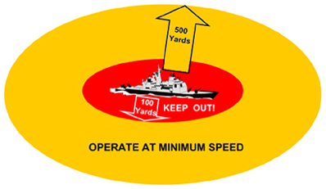
Security Zones

Slide 18
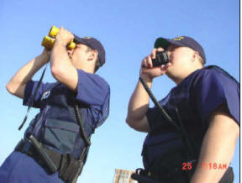
Homeland Security
Observe and avoid all security zones and other restricted areas. Avoid commercial port operation areas
Do not stop or anchor beneath bridges or in the channel
Keep a sharp eye out for anything that looks peculiar or out of the ordinary. Report all suspicious activities to local authorities, USCG, or port or marina security

Slide 19
PFD Requirements
One per person (Type I, II, III, or V)
One throwable (Type IV) per boat >16’
Children under 13 must wear one (underway <21’ unless moored or child is below deck in enclosed cabin)
Must wear on skis and PWC’s
Must have onboard all motorized and non-motorized vessels (kayaks, canoes, sail/paddleboards)
Good condition, readily accessible, and sized for user

Slide 20
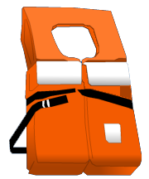
Type I:
Offshore Life Jacket
Minimum
Buoyancy
22 pounds
Notes:
Type I:
Offshore Life Jacket
PFDs come in all sizes depending on their use. They are classified as Type I Offshore Life Jacket, Type II Near-Shore Life Jacket, Type III Flotation Aid, Type IV Throwable and Type V Special Use Device.
Type I
These PFDs provide the most buoyancy. They are effective for all waters especially open, rough or remote waters where rescue may be delayed. They are designed to turn most unconscious wearers in the water to a face-up position.

Slide 21
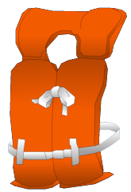
Type II:
Near-Shore Vest
Minimum
Buoyancy
15.5 pounds
Notes:
Type II:
Near-Shore Vest
These vests are intended for calm, inland water or where there is a good chance for quick rescue. This type will turn some unconscious wearers to a face-up position in the water but it will not turn as many as persons to a face-up position as a Type I under the same conditions.

Slide 22
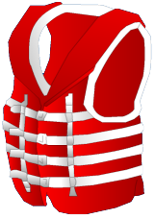
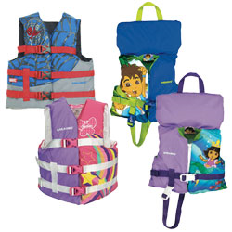
Type III:
Flotation Aid
Minimum
Buoyancy
15.5 pounds
Notes:
Type III:
Flotation Aid
These vests are good for calm, inland water or where there is a good chance for quick rescue. They are designed so wearers can place themselves in a face-up position in the water. The wearer may have to tilt their head back to avoid turning face down in the water. It is generally the most comfortable type for continuous wear. Float coats, fishing vests and vests designed with features suitable for various sports activities are examples of this type of PFD.

Slide 23
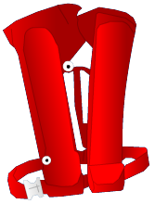
Type III/V:
Inflatable PFD
Minimum
Buoyancy
22 pounds
Notes:
Type III/V:
Inflatable PFD
Inflatable PFDs are more conferrable and less cumbersome than other PFDs. They are frequently worn by sailors working the foredeck.
They should only be warn by adults who are good swimmers.
DO NOT inflate prior to jumping into the water! Serious injury may result do to the high buoyancy (up to 35 lbs.).
Not for USE by PWC operators (they are not high impact rated!).

Slide 24
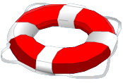

Type IV:
Throwable Device
Must have on board
Notes:
Type IV:
Throwable Device
These cushion or ring buoys are intended for calm, inland water with heavy boat traffic, where help is always present. They are designed to be thrown to a person in the water and grasped and held by the victim until rescued. They are NOT designed to wear.
You MUST have one onboard while underway.

Slide 25
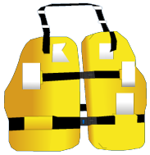
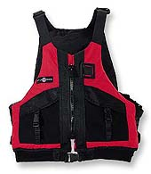
Type V:
Special-Use Device
Notes:
Type V:
Special Use
These windsurfing vests, decksuits, hybrid PFDs and others are intended for specific activities and may be carried instead of another PFD only if used according to the label. Some Type V devices provide significant hypothermia protection.
Ask the students to discuss how each of the five types must be deployed and what are the requirements for each type.

Slide 26
HIGHER BUOYANCY MEANS HIGHER LIFT
Type PFDs | Minimum Adult Buoyancy in Pounds (Newtons)
I - Inflatable | 33.0 (150)
I - Buoyant Foam or Kapok | 22.0 (100)
II - Inflatable | 33.0 (150)
II - Buoyant Foam or Kapok | 15.5 (70)
III - Inflatable | 22.0 (100)
III - Buoyant Foam | 15.5 (70)
IV - Ring Buoys | 16.5 (75)
IV - Boat Cushions | 18.0 (82)
V - Hybrid Inflatables | 22.0 (Fully inflated) (100) 7.5 (Deflated) (34)
V - Special Use Device - Inflatable | 22.0 to 34.0 (100 to 155)
V - Special Use Device - Buoyant Foam | 15.5 to 22.0 (70 to 100)

Slide 27






Types Of Fires
Trash Wood Paper
Liquids Grease
Electrical Equipment
Notes:
Types of Fires
Fires come in three types:
A - Combustible Materials (Wood, paper, fiberglass).
B – Flammable Liquids (Oil, grease and gasoline).
C – Electrical

Slide 28
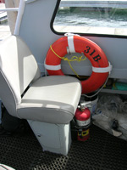
Fire Extinguishers
Should be on all vessels
Notes:
Fire Extinguishers
Federal regulations mandate that all vessels have the appropriate type and number of fire extinguishers onboard. These extinguishers should be charged and easily accessible. More information on fire extinguishers is contained in the following slides.

Slide 29
Fire Extinguishers
Dry chemical most common for marine use
Type B required onboard
  Inboard or I/O engines
  Permanently installed fuel tanks
  Closed living spaces
  Closed compartments where portable fuel tanks are stored
Notes:
Fire Extinguishers, continued
Fire extinguishers come in three types: A,B and C or combinations of these such as BC or ABC. They are normally suffixed with a number suffix indicating the size of the extinguisher. The type letter on the extinguisher indicates the type of fire for which the extinguisher is designed, based on the material involved.
To make sure your extinguisher(s) are ready when you need them inspect them regularly. The boat owner should also agitate them to make sure the dry chemical inside has not solidified.
Type B extinguishers are required onboard if one or more of the following conditions exist:
Inboard engine(s).
Permanently installed fuel tanks.
Closed living spaces.
Closed compartments and compartments under seats where fuel tanks may be stored.
Double bottoms not sealed to the hull or which are not completely filled with flotation materials.
Closed stowage compartments in which combustible or flammable materials are stored.

Slide 30
Federal Rules For Fire Extinguishers
<26 feet 1 B-1
26 feet to <40 feet 2 B-1
40 feet to <65 feet 3 B-1
Note: These are minimums
Notes:
Federal Rules for Fire Extinguishers
Approved types of fire extinguishers are identified by the following marking on the label: “Marine Type USCG Approved”, followed by the size and type symbols and the approval number. Use the following chart to determine the type and size requirement for your boat. Remember, these are MINIMUM requirements.
Length Without Fixed System With Fixed System*
Under 26’ 1 B-1 None
26’ - <40’ 2 B1 or 1 BII 1 B-1
40’ - <65’ 3 B-1, or 1 B-1 and 1 B-II 2 B-1 or 1 B-2
A fixed system is a permanently installed fire extinguisher.
Note: Cover the VSC requirements for inspection of fixed systems.

Slide 31
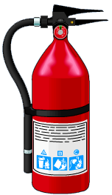
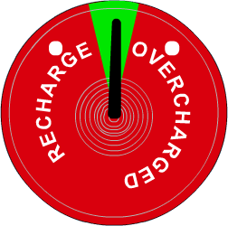
Charge Indicators
Notes:
Charge Indicators
Extinguishers should be inspected at least once a month. During the inspection:
Make sure seals and tamper indicators are not broken or missing.
Pressure gauges or indicators read in the operating range (Note: CO₂ extinguishers do not have gauges). Replace extinguishers that are not fully charged.
There is no obvious physical damage.
The weights of the extinguishers meet the minimum weights stated on the extinguisher labels (Check annually).

Slide 32
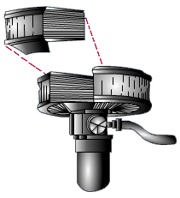
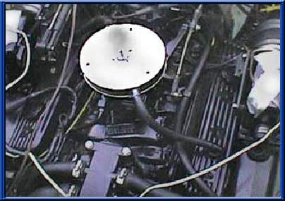
Backfire
Flame Arrestor
Required on gasoline engines
installed after April 25, 1940
Notes:
Backfire Flame Arrestor
Because boat engines may backfire, gasoline engines installed in a boat after April 25, 1940, except outboard motors, must be equipped with an acceptable means of backfire flame control. The device must be properly attached to the air intake with a flame tight connection and is required to be U.S. Coast Guard approved. Periodically clean the flame arrestor and check for damage.

Slide 33
Proper Ventilation
Required on gasoline powered boats
Powered ventilation on boats built
after 31 July 1980
Natural ventilation for boats built
before 1 August 1980
Notes:
Proper Ventilation
Proper ventilation is crucial. The purpose of ventilation systems is to avoid explosions by removing flammable gasses. Properly installed ventilation systems greatly reduce the chance of a life-threatening explosion. There are two types of ventilation systems: powered and natural.
Proper ventilation systems are required on all gasoline powered boats.
Powered ventilation systems are required on boats built after 31 July 1980.
Natural ventilation systems can be used on all boats built before 1 August 1980.

Slide 34
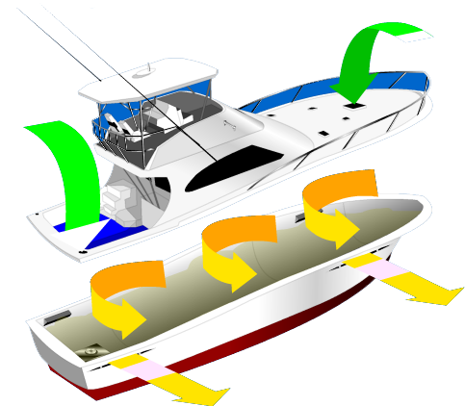
Proper Ventilation
Powered ventilation
Notes:
Proper Ventilation, continued
Powered Ventilation
A powered ventilation system is required for each compartment in a boat that has a permanently installed gasoline with a cranking motor for remote starting. If your boat is equipped with a power ventilation system or blower, turn it on at least four minutes prior to starting your engine, especially after fueling.

Slide 35
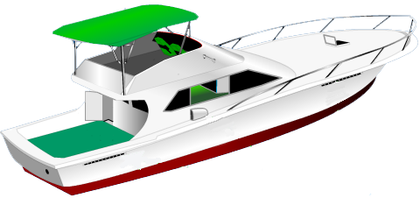
Proper Ventilation
Natural ventilation
Notes:
Proper Ventilation, continued
Natural System
A natural ventilation system comprises a cowl or intake opening from the atmosphere, from a ventilated compartment or from a compartment that is open to the atmosphere; an exhaust opening to the atmosphere or into another ventilated compartment.
An exhaust opening is required for each of the following compartments:
Compartments that contain:
A permanently installed gasoline engine.
A permanently installed fuel tank and an electrical component that is not ignition protected.
A fuel tank that vents into that compartment, including portable fuel tanks.
A non-metallic fuel tank.
Openings from another compartment that require ventilation.
Regardless of the type of ventilation in your boat, all owners are responsible for keeping their ventilation systems in operating condition. This means making sure all openings are free of obstructions, ducts are not blocked or torn, blowers operate properly and worn out components are replaced with equivalent marine type equipment.

Slide 36
Mufflers
Excessive noise can prevent vessel operator from hearing signals and voices
All vessels manufactured after January 1, 1990 must be equipped with muffler system in good working order and in constant operation to suppress engine noise
You may not remove or modify a muffler or muffling system if it results in an increased noise level

Slide 37

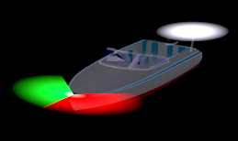
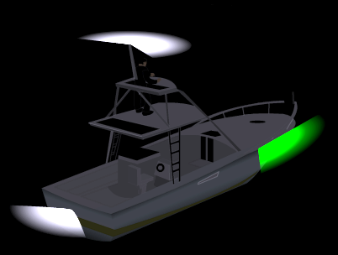
Lights – Under Power
Sunset to sunrise
Restricted visibility
Range of visibility
Example:
In vessels of less than 12
  meters in length:
  a masthead light, 2 miles;
  a sidelight, 1 miles;
Notes:
Lights – Power Driven
Boat operators must make sure that their boats are equipped with the proper navigation lights during the following conditions:
When away from the dock between sunset and sunrise.
During periods of restricted visibility such as fog or heavy rains.
The lighting visibility requirements for vessels vary based on boat length. For vessels under 20 meters (39.4') they only need to be visible for one mile. Vessels over 20 meters require visibility of two miles.

Slide 38
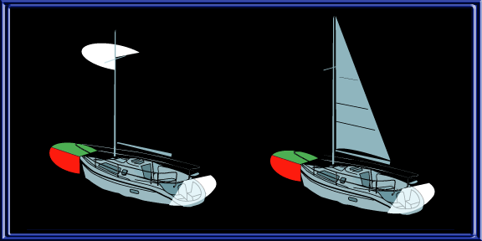
Lights – Sailboat
Notes:
Lights – Sailboat
Manually driven boats are sailboats or those that are paddled, poled or rowed. If less than 20 meters long (65.6’), these boats must exhibit the lights as indicated.
For more information on light requirements please refer to Chapter 3.

Slide 39
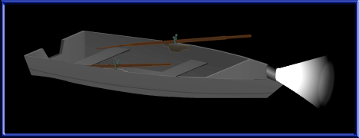
Lights
< 23’ or 7 meters
under oars
Notes:
Lights
If less than 7 meters, or 23.0’, manually driven boats must exhibit the lights as indicated.
At least one lantern or a flashlight shining a white light from the bow.
If practical, display the same lights as manually-driven boats less than 20 meters (65.6’) in length.

Slide 40

Visual Distress Signals
Three hand held red flares
Day and Night
Service life: 42 Months
Notes:
Visual Distress Signals
Visual Distress Signals (VSDs) allow a boat operator to signal for help in the event of an emergency. VSDs are classified as day signals (visible in bright sunlight), night signals (visible at night) or both day and night signals. VSDs are either pyrotechnic (smoke and flames) or non-pyrotechnic (non-combustible).
The following combinations of signals are examples if VSDs that could be carried aboard to satisfy U.S. Coast Guard requirements:
Three hand held red flares (day and night)

Slide 41

Or...
One Hand Held Red Flare & Two Red Meteors
Service life: 42 Months
Notes:
Or…
One hand held red flare and two meteors (day and night).

Slide 42
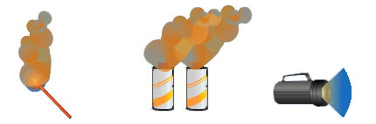
Or...
One hand held orange smoke
Two floating orange smoke
And one electric SOS light
Notes:
Or…
One hand held orange smoke signal (day), two floating orange smoke signals (day) and one electric light (night only).
Regulations prohibit display of visual distress signals on the water under any circumstances unless when assistance is required to prevent immediate danger to persons aboard a boat.

Slide 43


Other VSDs
Arm signal
Not USCG approved
Use if no other
Orange flag
Day signal only
Notes:
Other VSDs
While not a U.S. Coast Guard approved VSD, the use of arm signals can also be employed to summon help. Use this action if you do not have any other visual distress signals available. Extend your arms out to the side from the shoulder and move up and down in a +/- 40° arc.
The orange flag that is contained in most VSD kits can be used during daylight hours.

Slide 44
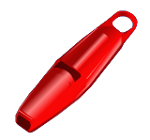
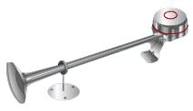
Sound Producing Devices
Boats less than 65’ (20 m) must carry a sound producing device, e.g., whistle, horn, etc.
Notes:
Sound Producing Devices
In periods of reduced visibility or whenever a boat operator needs to signal his or her intentions or position, a sound producing device is essential. The sound producing device may be a whistle, horn or a bell that is audible for one-half mile.
Boats less than 12 meters (39.4’) (this includes PWCs) must carry a whistle or a horn.

Slide 45

Sound Producing Devices
Boats greater than 65’ (20 m) must carry a bell (in addition to other device)
Notes:
Sound Producing Devices, continued
Boats that are 12 meters in length (39.4’) or greater are required to carry a horn or whistle AND a bell.

Slide 46
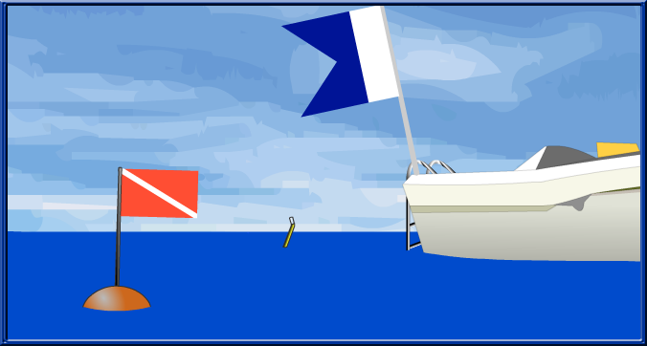
Diving/Snorkeling Flags
Avoid placing in:
  Areas already occupied by boaters
  Narrow channels
Notes:
Diving/Snorkeling Flags
Avoid placing these flags in areas already occupied by boaters or narrow channels. It is not safe to dive or snorkel in these areas.
Note: Discuss your local or state requirements for diving or snorkeling.

Slide 47
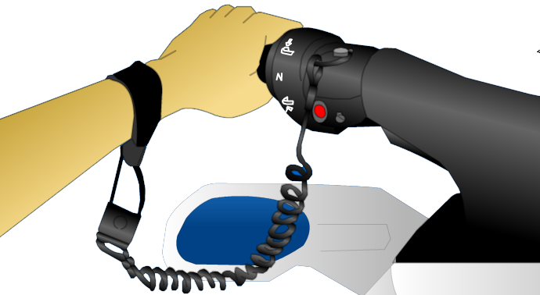
Requirements
Specific To PWC
Education requirements
State registration
PFD required
Lanyard required:
essential for engine cutoff
No operations between sunset and sunrise
Notes:
Requirements Specific to PWC
In addition to adhering to boating laws, PWC operators have requirements specific to their watercraft. The specific regulations for PWC operation vary from state to state.
Many states have such laws as:
Mandatory education requirements.
State certification to operate a PWC.
Each person riding a PWC must wear a Type I, II, III or V PFD.
PWC must be equipped with a fully functional self-circling device or a lanyard type safety ignition switch.
It is illegal to operate a PWC between sunset and sunrise.
It is illegal to jump the wake of another boat unnecessarily close to the other boat or when visibility around the other boat is restricted.
It is illegal to chase, disturb or harass wildlife with your PWC.
A PWC must be operated at idle speed if within a specified distance of a non-moving boat, dock or pier, bridge or person in the water.

Slide 48
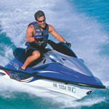
PWC (cont’d)
Prudent operation
  Speed <6 kts within 100’ of shore, persons
  Speed <6 kts within 100’ of another vessel unless overtaking or crossing
  Speed: slow, no wake in water less than 18” deep

Slide 49
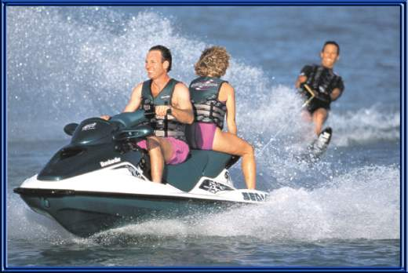
Towing Requirements
Boat Or PWC
No skiing or towing between sunset and sunrise
PFD required for towed person
PWC must be rated for 3 persons: observer required
Notes:
Towing Requirements Boat or PWC
In addition to adhering to laws as they apply to all boats and PWC, boat and PWC operators towing a person(s) on water skis, surfboard or similar device may have additional laws to which they must adhere. The specific laws for towing persons on water skis or other devices vary from state to state. (Note: discuss your state laws as they pertain to towing persons on water skis or similar devices.)
Generally:
A PFD is required for the person(s) being towed.
A dedicated observer is required.

Slide 50
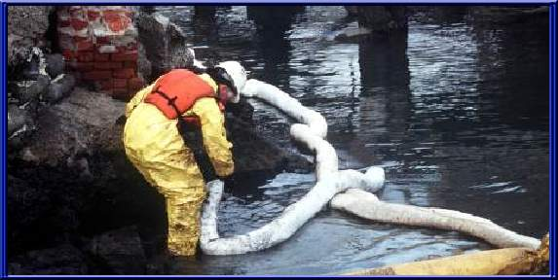
Waste and Trash
Sewage carries harmful bacteria:
use pump out stations
Do not throw any trash overboard
Notes:
Waste and Trash
It is illegal to discard untreated waste, oil or trash into any Federally controlled or state waters for very good reasons:
Sewage carries disease and is harmful to people, aquatic plants and animals.
Trash thrown into the water can injure swimmers and wildlife alike. It can also plug engine water cooling intakes.
Pollution is unsightly and takes away from you enjoyment of the water.
The Refuse Act prohibits throwing, discharging or depositing any refuse matter of any kind (including trash, garbage, oil and any other pollutants) into the waters of the United States. The discharge of trash, which falls under the Act to Prevent Pollution from ships, places limitations on the discharge of garbage from boats. It is illegal to dump garbage and plastics into federally controlled or state waters.
A durable placard (sign) measuring at least 4” x 9” must be displayed in a prominent location notifying passengers and crew about discharge restrictions.
You must store trash in a container onboard and place it in a proper receptacle after returning to shore.

Slide 51
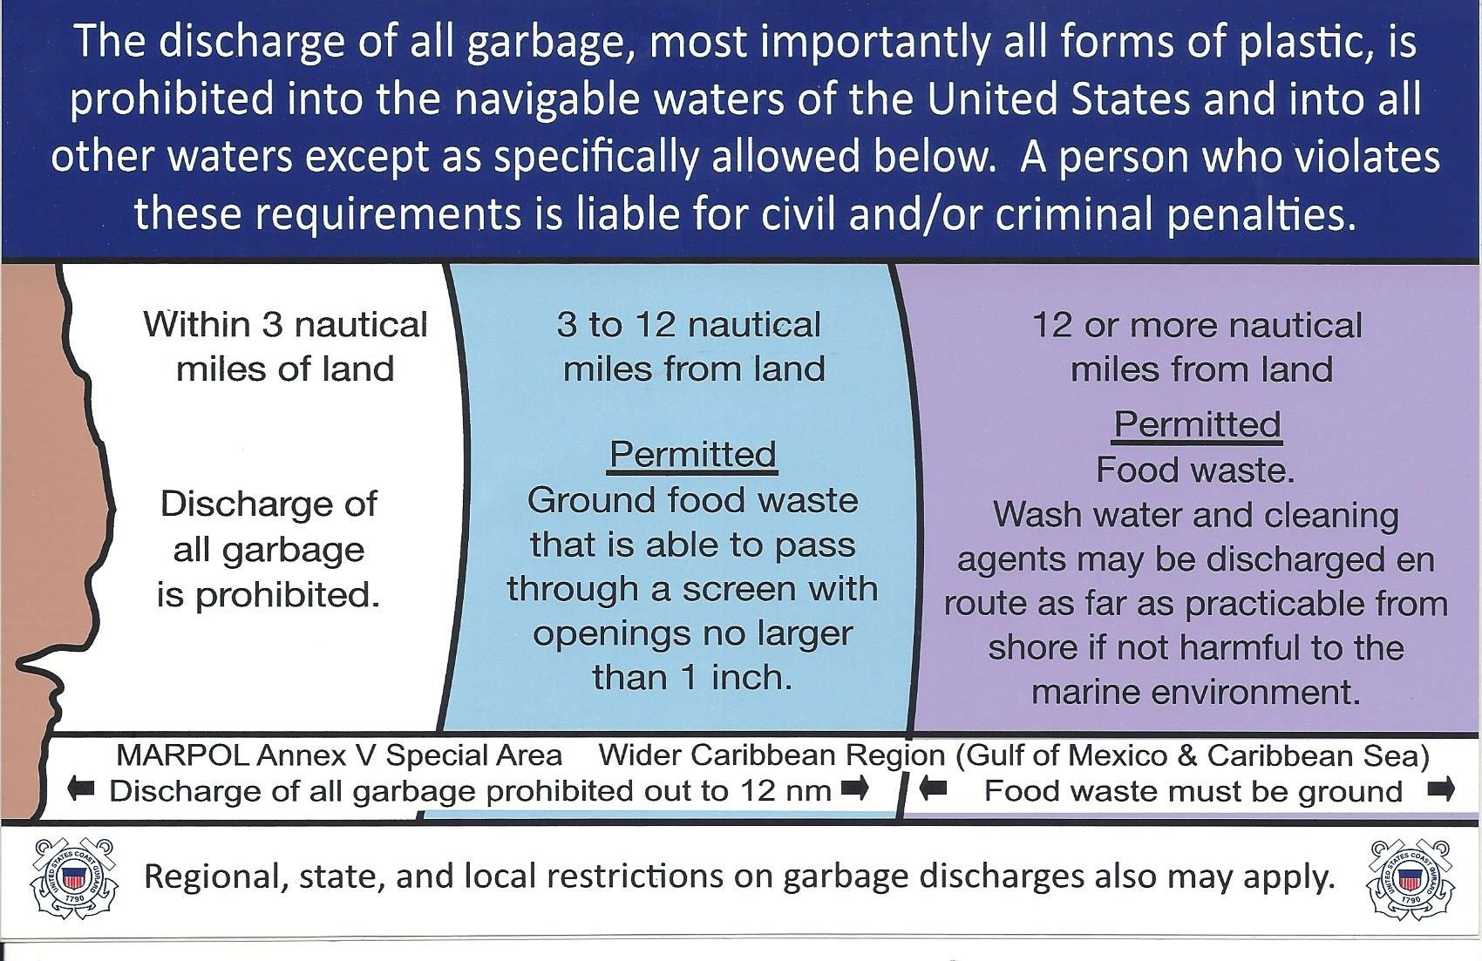
Environmental Protection
Pollution regulations
  Placard required vessels greater than 26 feet
Notes:
Environmental Protection
All boat operators are required to obey federal and state laws regarding the disposal of trash. All vessels over 26’ in length are required to prominently display a placard outlining proper trash disposal.

Slide 52
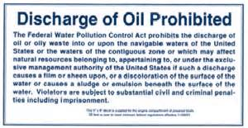
Oil/Fuel Spills
Spills: Thimble of fuel or more should be reported:
US Coast Guard
Delaware DNREC Emergency Response Team
Placard displayed for vessels >26’
Fines up to $10,000
Notes:
Waste and Trash, continued
The discharge of oil and hazardous substances is strictly prohibited by the regulations issued under the Federal Water Pollution Control Act. This act requires all boats with propulsion machinery to have a capacity to retain oil mixtures onboard.
You are not allowed to discharge oil or hazardous substances.
You are not allowed to sump oil into the bilge of the boat without means for proper disposal.
You must discharge oil wastes to a reception facility.
On recreational boats a bailer or bucket is adequate.
You must immediately notify the U.S. Coast Guard if your boat discharges oil or hazardous substances in the water. Call toll free 1-800-424-8802. Report the discharge’s location, color, source, substances, size and time observed.
If your boat is 26’ or longer you must display a 5” x 8” placard made of durable material fixed in a conspicuous place in the machinery spaces, or at the bilge pump control station stating the following:
Show the students a placard and read them the verbiage required.

Slide 53

Marine Sanitation Devices
Type I or II
  Chemically treated
Type III
  Holding tank only for pump-out or discharge beyond 3 miles off-shore
Notes:
Marine Sanitation Devices
If you have a boat with installed toilet facilities, it must have an operable marine sanitation device (MSD) onboard. MSDs come in three types: I, II and III.
Type III MSD, the simplest, consists of holding tanks. It requires only a small storage space and is simple to operate. Type III MSDs have the least effect on the environment since the water is discharged on shore into a local sewage treatment facility.
Types I and II are usually found on larger boats. Waste is treated with special chemicals to kill bacteria before the waste is discharged. Types I and II MSDs with “Y” valves that direct waste overboard must be secured so that the valve cannot be opened. This can be done by placing a lock or non-reusable seal on the “Y” valve or taking the handle off the “Y” valve.

Slide 54
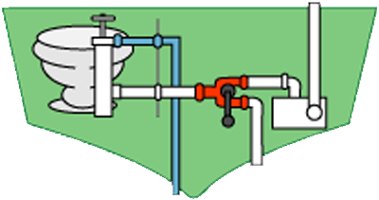
Marine Sanitation Devices – Type III
All MSD’s Must Be USCG Approved
Notes:
Devices – Type III
Recreational boats must comply with the appropriate USCG-approved MSD in accordance with the length of the boat.
Boats 65’ in length and under may use a Type I, II or III MSD
Boats over 65’ must install a Type II or Type III MSD.
All installed devices must be U.S. Coast Guard-certified. U.S. Coast Guard-certified devices are so labeled, except for some holding tanks certified by definition under the regulations.

Slide 55
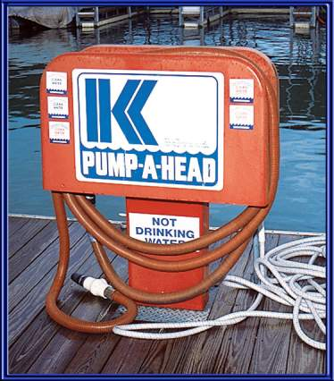
Use Pump Out Stations
Notes:
Use Pump Out Stations
The best way to ensure that you do not violate any federal or state laws regarding waste disposal is to use approved pump out stations.

Slide 56
No Discharge Zones
No discharge of any waste, even treated waste from MSD type I and II
None in Delaware

Slide 57
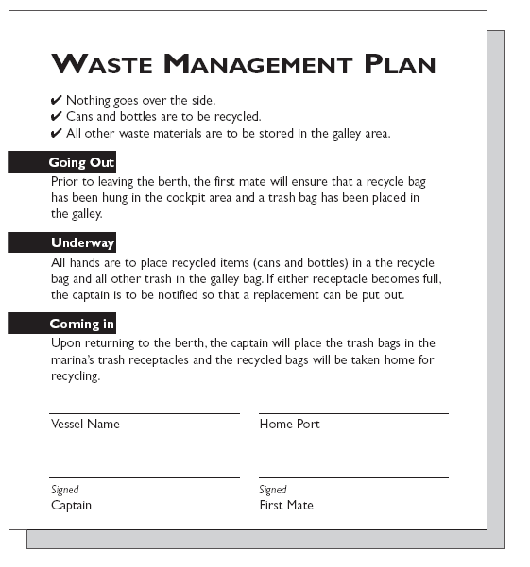
Waste Management Plan
Vessels greater than 40 feet with galley and berths must have a written plan
Captain is responsible for implementation
Plan should be posted with directives for crew and passengers
Notes:
Waste Management Plan
Vessels longer than 39.4’ must have a written waste management plan onboard at all times. This plan outlines how and where the operator will collect trash and how it will be disposed once the operator reaches shore.
The captain of ocean-going vessels is responsible for the implementation of this plan.

Slide 58
Aquatic Nuisances
To prevent the spread of non-native fish and mollusks in our waterways, boaters should follow these simple rules:
Trailer boaters should remove visible mud, plants, fish or animals from boats and trailers prior to transport to another body of water.
Scrape any mussels from boat or outdrive, and flush hull, bilges & water holding compartments with hot water (at least 120º F).
Do not release plants or fish, including bait, into a body of water unless it came out of that same body of water.
Notes:
Aquatic Nuisances
Boaters have a responsibility to help prevent the spread of aquatic nuisances, such as Zebra Mussels. We must make sure we clean our boats to keep from unknowingly transporting mussels from one area to another.
Proper hull maintenance and engine flush will reduce the chances of the spread of these and other nuisances.

Slide 59
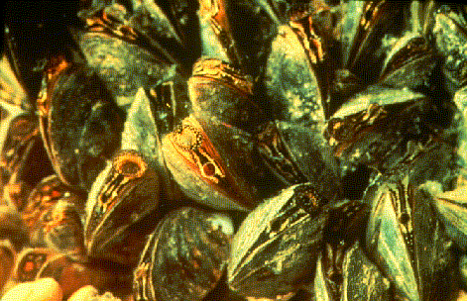
Aquatic Nuisances
Pump fresh water through engines before leaving the area.
Empty water out of kayaks, canoes, rafts, etc.
Let boat, PWC's, trailer and equipment dry for at least 5 days.
Notes:
Aquatic Nuisances, continued
Proper preventative actions include:
Pumping fresh water through your engine(s).
Drain all live wells, bait buckets, bilge and any other wells in your boat.
Remove as much water from your boat as possible by removing the drain plug and allowing water to drain.
After removing all the water you can from your boat, PWC, canoe or kayak let the equipment dry for at least five days.

Slide 60
Accidents
Stop and provide assistance; exchange information
Accident reports must be filed within 24 hours, if death, missing or medical treatment beyond first aid
If vessel is lost, or damage is over $500,
  Report must be filed within 5 days
Notes:
Accidents and Casualties
All boating accidents (or those that meet the criteria below) must be reported by the operator or owner of the boat to the proper law enforcement authority for the state in which the accident occurred.
Report the accident:
Immediately in the event of fatal accidents.
With a formal report within 48 hours if a person dies, or there are injuries requiring more than first aid.
With a formal report within ten days for accidents involving more than $2000 damage or the total loss of a boat. (State and local regulations for reporting accidents may vary.)
If you observe a boating accident remember that you are required by law to stop and render whatever assistance is necessary to any person involved in a boating accident or in danger at sea unless the action would endanger your own boat, crew or passengers. The operator is subject to a fine, imprisonment or both for failure to do so.
All boats hailed by the USCG MUST stop. Civil penalties or imprisonment can result for non-compliance.

Slide 61
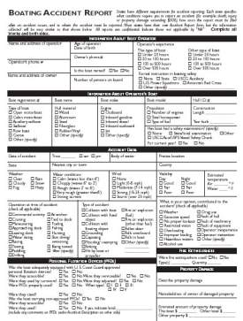
Accident Reporting

Slide 62
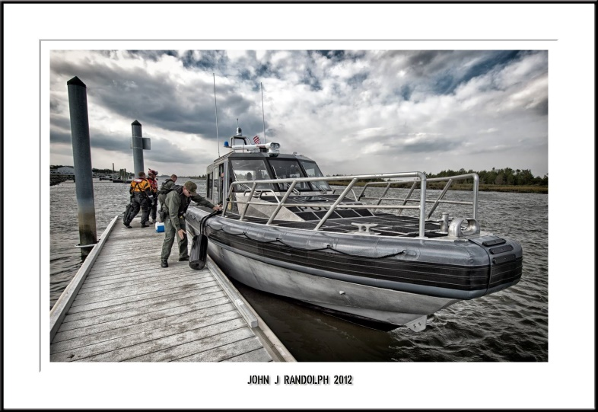
Enforcement
Delaware Fish & Wildlife Natural Resources Police and the USCG can stop and board your vessel
Yield right of way, stop vessel and stay in position until police have passed
Notes:
U.S Coast Guard
Just like roadways there are law enforcement personnel on the waterways and boating violations may incur penalties. Personnel who are authorized to stop and board your vessel include:
U.S. Coast Guard – A boat underway when signaled by a USCG vessel is required to maneuver so a boarding officer can come on board.
Other federal, state and local law enforcement officials may board and examine your boat whether it is numbered, unnumbered or documented. U.S. Coast Guard personnel may also be found onboard other vessels.

Slide 63
Setting Anchor
Select a sheltered area
Approach into the wind or current
Lower the anchor until it reaches bottom
Pay out line for appropriate scope while backing down (7:1 recommended)
Back down hard to set the anchor
Check position periodically for drift
Notes:
Setting Anchor
Follow these steps to anchor your boat:
Select an area of little current, protected from the weather, preferably with a flat bottom.
Plan to lower your anchor well upwind of where you want the boat to end up.
Make your approach slowly into the wind or current.
Stop the boat and slowly lower the anchor over the bow, never the stern, until it reaches bottom.
Slowly back the boat away while playing out the rode.
When sufficient rode is played out tie the line around a bow cleat and back down hard to set the anchor.
Check your position with local landmarks and recheck them from time to time to see if you are drifting.

Slide 64
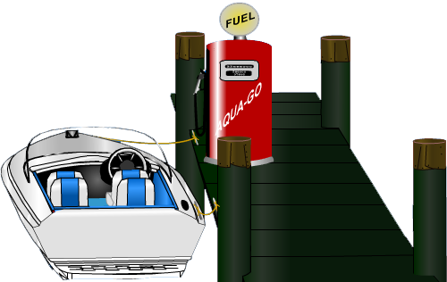
Fueling Safely
Portable tanks: Fill on dock
On-board tanks:
1. Close hatches and portholes
2. Keep fuel nozzle in contact with deck plate
3. Do not overfill tanks
4. Ventilate bilge after fueling
5. Open all hatches
and portholes
Notes:
Fueling Safety
Serious accidents can occur when fueling a boat; it is important that extreme care be taken. You can reduce the risks by maintaining your equipment in good condition and by following these safety procedures:
Explain the bulleted items on the slide. Talk about using common sense when fueling a boat.

Slide 65
Fueling Safely
Turn off all electrical/electronic equipment
Turn off bilge blower
After fueling, turn on bilge blower for
4 minutes prior to restarting
engine, then sniff test
Notes:
Fueling Safety
Serious accidents can occur when fueling a boat; it is important that extreme care be taken. You can reduce the risks by maintaining your equipment in good condition and by following these safety procedures:
Explain the bulleted items on the slide. Talk about using common sense when fueling a boat.

Slide 66
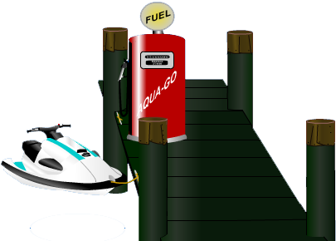
PWC: Fueling Safely
Keep fuel line closed
Check system for leaks
Fill tank slowly do not overfill
After fueling ventilate
engine compartment / sniff
Check for spills
Notes:
Fueling Safely continued.
Never fill a tank to overflowing. Leave room for the gas to expand, especially on a hot day.
Put the cap on tightly after fueling to prevent vapors from escaping.
Immediately wipe up any spills. Let the rag air-dry. NEVER throw it in the boat or in the water.
Always use approved safety tanks or cans. Wipe the tanks clean before putting them on the boat. Store them in a well-ventilated place away from the engine or ignition source.

Slide 67

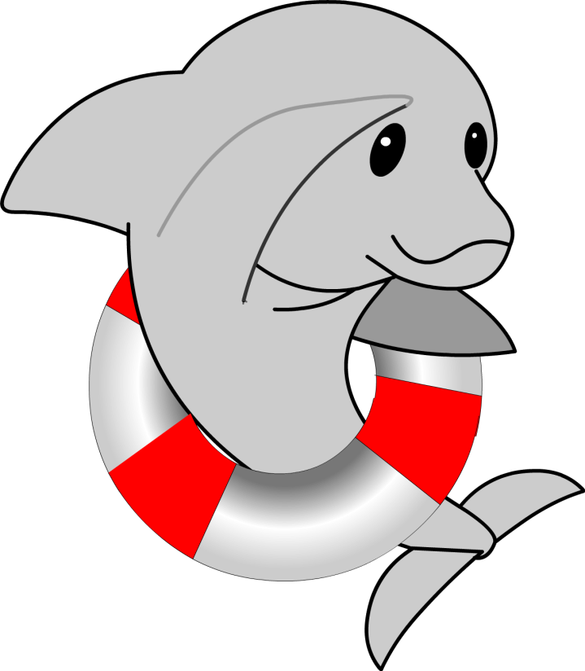
End Chapter 2
Notes:
End of Chapter 2

