Slide 1



Marketing & Membership Workshop
MARKETING WORKS

Slide 2
Disclaimer
Some of the illustrations and photos of logos and brands are out of date
But the concepts included in this presentation are relevant and may help your squadron with developing or improving its marketing activities

Slide 3
The Business Analogy
PLANNING & DESIGN –
Questions, Myths, Understanding, Engineering
What elements need to be included?
MANUFACTURING –
What are the most cost effective ways to produce our marketing materials?
DISTRIBUTION –
What are the best and most cost effective ways to get our marketing products in front of the public?

Slide 4
PLANNING & DESIGN
What do we need to know before we even try to get started?
What are we going to produce that answers the questions above and also fills our promotional needs and our mission?

Slide 5
Big Questions
Who are our customers?
What do we actually sell?
What do our customers really want?
How do we attract them to us?
How can we use our superior courses to a competitive advantage?
What can make us compelling?

Slide 6
Question Our Own Myths
Boating safety compels people to join
“Build it and they will come”
Uniforms attract people from the public
Pictures of our member demographic are good tools for marketing
If they are interested in joining, they will easily find out how to do so

Slide 7
Understand Our Customers - Members
Motivation and interest in education?
  Generally
  Topically
Do they think they need education?
Grade advancement?
Topics esoteric or relevant?
Too much work?

Slide 8
Understand Our Customers – All
Focus on them, not on ourselves
Need vs want
Recognize how people make decisions:
  Emotion vs rational
  Connection; sense of community
  Everything is a commodity

Slide 9
Design Elements
What elements need to be included?
Recognizable:
Branding Elements (logos, tags, colors, etc.)
Design Elements (borders, colors, stripes, etc.)
Complete Info:
Date, Phone, eMail, Web site, etc.

Slide 10
A Quick Word About Branding
Just add SAIL to the squadron name.
Change national name – must include boating.
McDonalds vs Burger King
GoDaddy vs Network Solutions
Amazon.com vs Buy.com (Rakuten)
It’s not the name, but how you use it.

Slide 11
Design Considerations
What attracts event attendees & new members?
Promotions? FREE Offers?

Slide 12
Design Considerations
What attracts event attendees & new members?
Promotions? FREE Offers?

Slide 13
Design Considerations
What attracts event attendees & new members?
Promotions? FREE Offers?
Eye/Ear Catching:
Exciting, Bold, Frightening, etc.

Slide 14
Design Considerations
What attracts event attendees & new members?
Promotions? FREE Offers?
Eye/Ear Catching:
Exciting, Bold, Frightening, etc.

Slide 15

Design Considerations
What attracts event attendees & new members?
Promotions? FREE Offers?
Eye/Ear Catching:
Exciting, Bold, Frightening, etc.

Slide 16
Design Considerations
What attracts event attendees & new members?
Promotions? FREE Offers?
Eye/Ear Catching:
Exciting, Bold, Frightening, etc.
High Resolution:
Minimum 200 dpi, Good photos

Slide 17
Engineering
Where do we want our materials placed?
We know about the elements and considerations, now we must tailor the design to fit the requirements of where
and how it will be used.
SIZE, SHAPE, AUDIENCE, PUBLICATION
For the decisions we need more info?

Slide 18
Understand Marketing and PR
What is Marketing and what is PR?
Are they different?
How are they used?
Can they be used synergistically?

Slide 19
Public Relations
Promotes a positive image
Aimed at public welfare
  Does not advertise specific products
  Not directly aimed at customer purchases or recruiting new members
Can identify us with our mission

Slide 20

Public Relations
Employs media as primary channels
  Traditional press releases etc. (passé)
  Freebies, buttons, pins, etc. with OUR logo
  Social Media (a must!)

Slide 21
Why Social Media?
Everyone (almost) is a user
Many people use social media as their PRIMARY source of information
Majority rely on personal recommendations via social media
First time boat owners often in this group

Slide 22
Marketing
It is not just advertising or selling
Marketing is a strategic function
Marketing plan linked to strategic vision
Serves as customer-advocate

Slide 23
MANUFACTURING
Borrow/Recycle Materials
What already exists?
Create New Materials
Tools, Staff, Content, Formats, etc.
Build Relationships
Connect with media outlets
Explore new outlets

Slide 24
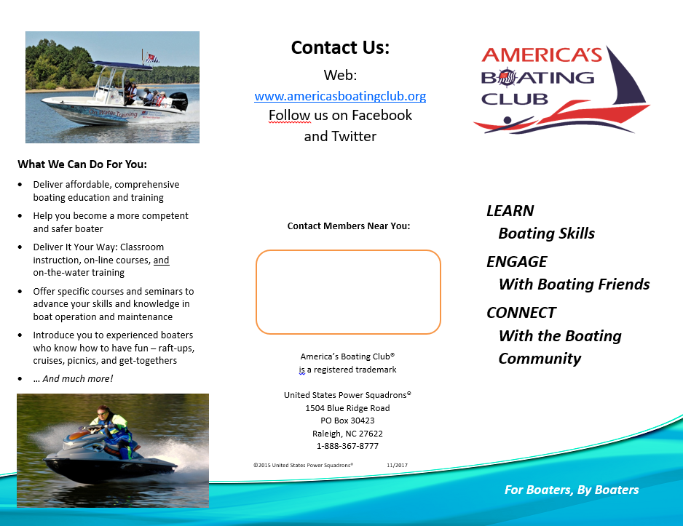
Modify Recycled materials
You don’t need to reinvent.
Add local contact information
substitute a local photos
Recycle text into your own creations
Somewhere Bay Power Squadron
1914 Bay Road
Somewhere Bay, USA
1-800-Some-Bay
somewherebay@usps.org

Slide 25
Create Your Own – Raw Materials
Photos and Graphics
Use Royalty Free (from USPS and others)
If not, get permission (in writing) to use
Use your own
Get permission from people in photos
Text, Logos, Slogans, Tag Lines
Materials available from USPS
Adjust text for local appeal if needed

Slide 26
Create Your Own – Machinery/Software
Bundled Software
You already have it (no or minimal cost)
PowerPoint, Publisher, Word, and others
Free Software
Joomla, Paint.net, CutePDF, PDFill, WSFTP
Low Cost Software
WYSIWYG WebBuilder

Slide 27
Create Your Own – Machinery/Software
Bundled Software
Created using PowerPoint
(You already have it)
Images adjusted using Paint.net (Free)
Converted to PDF
Using CutePDF (Free)

Slide 28
Create Your Own – Machinery/Software
PowerPoint You have it
Publisher You may have it
Acrobat Writer $15 to 150 MSPrintToPDF Win10 Included
CutePDF FREE
PDFill FREE
Photoshop $20/mo or $100+ Paint.net FREE
DreamWeaver $20/mo or $500+ Webbuilder $45
Joomla FREE
WSFTP FREE

Slide 29

Create Your Own – Machinery/Software
Publisher
Paint.net
PDFill
cmyk
600dpi

Slide 30
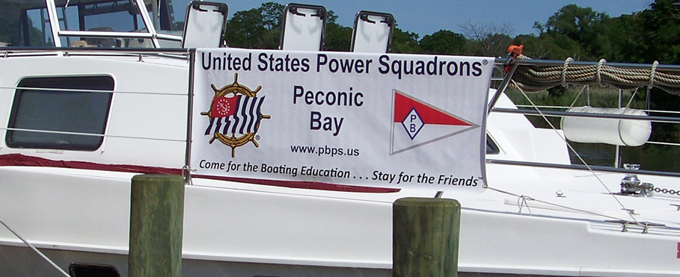
Create Your Own – Machinery/Software
5385x2265 banner created with Paint.net
to Staples specs

Slide 31
Labor
Squadron Volunteers: Squadron members have various talents. Do you know what they are? Divide the workload. (Writers, Graphic Artists, and others)
Donated Time: Local businesses sympathetic to our mission may be able to help with specific tasks. Start small and don’t expect them to do everything.
Paid Help: You may be able to do most tasks, but still need to pay for specific work like printing.

Slide 32
DISTRIBUTION
What are the best and most cost effective ways to get our marketing products
in front of the public?
Location, Location, Location
Develop Relationships
Electronic Distribution (Format Conversion)
All Require More Labor

Slide 33
DISTRIBUTION
Promotion Defined - a call to action
Promotes education and membership directly to individuals
  Not public service announcements
  Not generalized statements about safety
  Not education
  (These are PR which is also useful, but be aware
  of the difference and use appropriately.)
Not materials from other organizations

Slide 34
DISTRIBUTION
Marketing to members and non-members
IS DIFFERENT
Come for the Boating Education
is the bait for non-members.
Newsletters, eMail blasts & meeting pitches
are nourishment for existing members.
Collect contact info from both.
(from boat shows, classes, friends, etc. – Build a Database)

Slide 35
DISTRIBUTION
Target what you send to appropriate groups.
Adjust distribution timing for publication due dates, class or event schedules, highest readership times, holiday schedules, etc.
Follow up with 2nd or 3rd distribution.
Use tools like Constant Contact, MailChimp, or One Call.

Slide 36
Location, Location, Location
(for both Marketing and PR – be everywhere possible)
Web Sites, Social Media, eMail
Newspapers, Magazines (relationships)
Signs, Stickers, Magnets
Posters, Flyers, Business Cards
Presentations, Boat Shows, Simulator
Classes, Seminars, Safety Demonstrations
Apparel, Name Tags, Personal Contact
Partnerships, Public Events

Slide 37
POP Quiz – Marketing, PR or Both
Web Sites, Social Media, eMail
Newspapers, Magazines (relationships)
Signs, Stickers, Magnets
Posters, Flyers, Business Cards
Presentations, Boat Shows, Simulator
Classes, Seminars, Safety Demonstrations
Apparel, Name Tags, Personal Contact
Partnerships, Public Events

Slide 38
Consider This as we look at the slides that follow.
Squadrons and Districts want to purchase ads, but budgets are extremely limited.
There are many marketing and PR opportunities available for free or low cost.
Most squadrons take advantage of about 10% of these free or low cost opportunities.
Why buy?

Slide 39
Web Sites, Social Media, eMail
Web sites are low cost, easy with modern software and they are always on.
(Course Schedule, Event Calendar, and More - Get others to link to you)
ITCom’s Standard Squadron Site (SSS) is available for squadrons that want to use it. The SSS includes automatic:
Standard branding (logos, colors, etc.), Squadron Name, Burgee, Officer Names, Public Contact Info, Class Schedule (from HQ800), Social Event Listings (from on line event form), Standard course, seminar & what a squadron is descriptions

Slide 40
Web Sites, Social Media, eMail
Web sites are low cost, easy with modern software and they are always on.
(Course Schedule, Event Calendar, and More - Get others to link to you)
Social media is FREE, always on, but production must provide interesting content.
eMail signatures are FREE and provide a way to spread our message with every email you send.

Slide 41
Newspapers & Magazines
(Build Relationships)
Paid ads only appear in editions paid for.
Long term deals are better, but expensive.
Must target by region or demographic.
Free announcements are cost effective.
Only get space when events are scheduled.
List more events not less. On line forms take longer. Never attach word files.
Squadron writers submit articles. (PR)
Relationships with editors = events get listed

Slide 42
Newspapers & Magazines
(and any electronic distribution)
Format Conversion
How do they want it?
How can any anyone see it correctly?
Do they accept attachments?
Is it cross platform?
.doc .docx .pdf .ppt .pptx. .pub .qxd .jpg .tiff .gif .png .bmp RGB CMYK
You may work in one format but need to convert when you distribute.

Slide 43
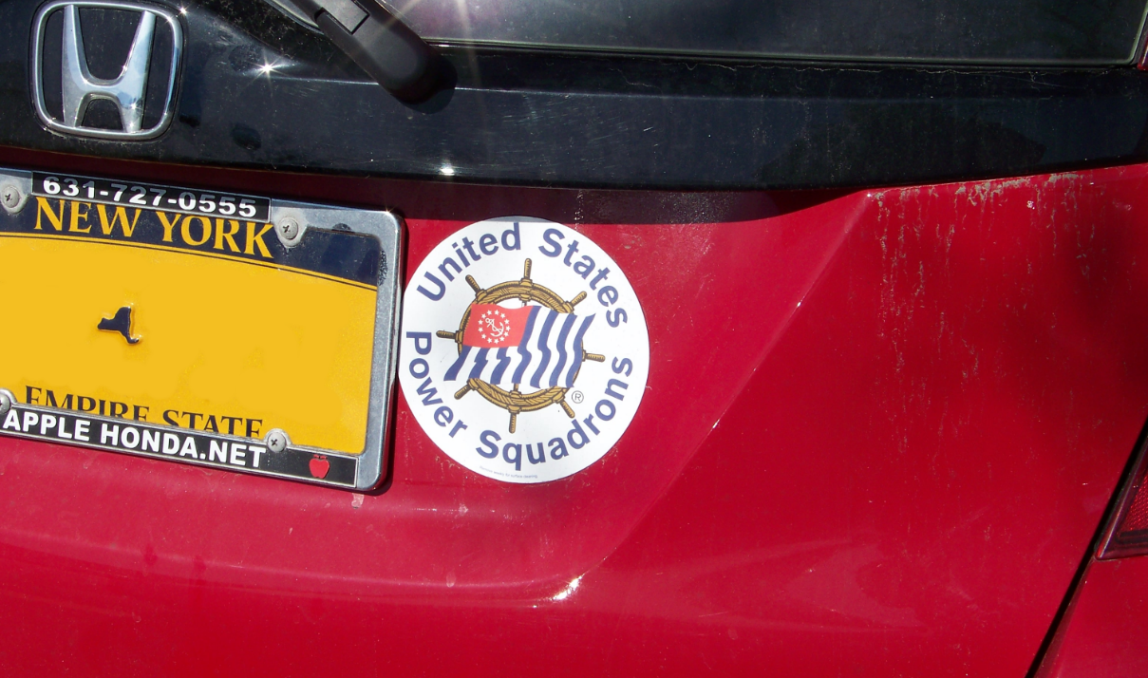
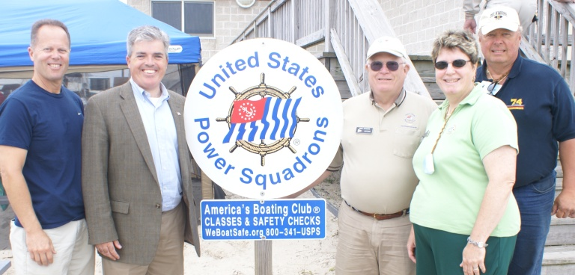
Signs, Stickers and Magnets
Permanent, long lasting, low cost items are more cost effective than single use items.
Your mission – find places to put them.

Slide 44




Posters, Flyers, Business Cards
(Build Relationships)
Posters, Flyers, Trifolds at marinas, W.Marine, in store windows, or hand out flyers for events.
Business cards are about personal contact.
TODAY
9:00am - 3:00pm

Slide 45
Presentations, Boat Shows, Simulator
Use premade presentation (shown earlier) at yacht clubs, civic meetings and more.
Boat shows reach your target demographic, but is your display attractive with good promotional materials ready to distribute?
Simulator attracts people to your booth.
Children love it – then pitch the parents.

Slide 46
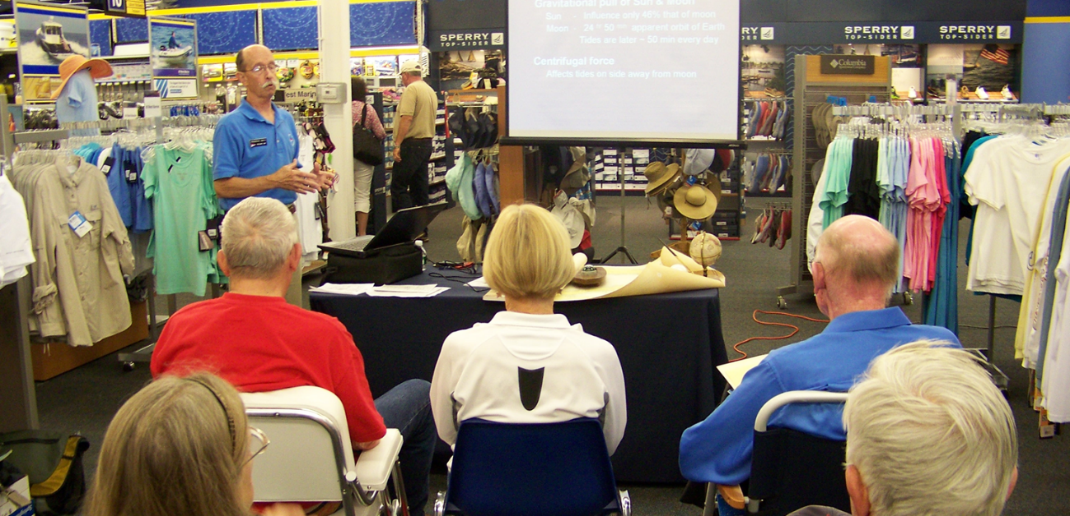
Classes, Seminars, Safety Demonstrations
You created and sent materials to promote your event, but when the event happens, is its visible to the public, so the event itself can be used to promote and sell the next event?
Is there any follow up promotion?
(look what happened press release)

Slide 47
Classes, Seminars, Safety Demonstrations
(Follow Up Recruitment - SALES)
Do you have a recruitment folder including;
Brochure, Newsletter, Business Card, Registration form, Member Application
Are you;
Using Promotional PowerPoint, Establishing Credentials
Do you reinforce this with instructors?

Slide 48
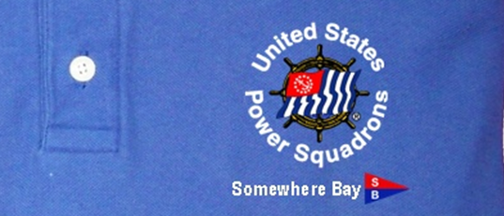
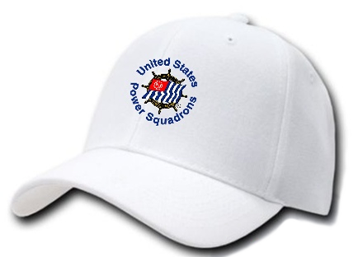

Apparel, Name Tags, Personal Contact
Every time you put on a squadron shirt, hat, name take, uniform or anything squadron related, you are advertising and marketing.
Are you creating a positive image. Are you prepared for questions from the public?
This is an opportunity for personal contact.

Slide 49
More on Personal Contact - Sales
We are all salesmen/saleswomen
You represent your squadron and USPS.
Just be friendly and engaging; be yourself
Don’t say we are the best,
instead, explain USPS in a way they’ll reach
that conclusion themselves.
LISTEN, LISTEN, LISTEN before telling
them everything you know about USPS.

Slide 50
More on Personal Contact - Sales
IDENTIFY THEIR INTERESTS
Focus should be on them, not us.
What kind of boating do they do? Where?
Why might they want education?
What need does it meet?
What about spouse/significant other?
How about prospective new boat owner?
Others???

Slide 51
More on Personal Contact - Sales
What are their specific needs?
What needs can we fill?
It’s not just about safety
  Comfortable competence on the water
  Buying a first boat
  Boating knowledge for knowledge sake
  Want to socialize with other boaters
  Being compliant with state requirements
  Saving on insurance premiums

Slide 52
More on Personal Contact - Sales
Respond to THEIR needs
Feedback your understanding. Provide explanation, information, and examples of how we can meet the needs just identified.
Ask for their general reaction & invite them to take the next step. (course, meeting, etc.)
Do NOT leave it with “look at our website”
or expect them to call on their own.

Slide 53
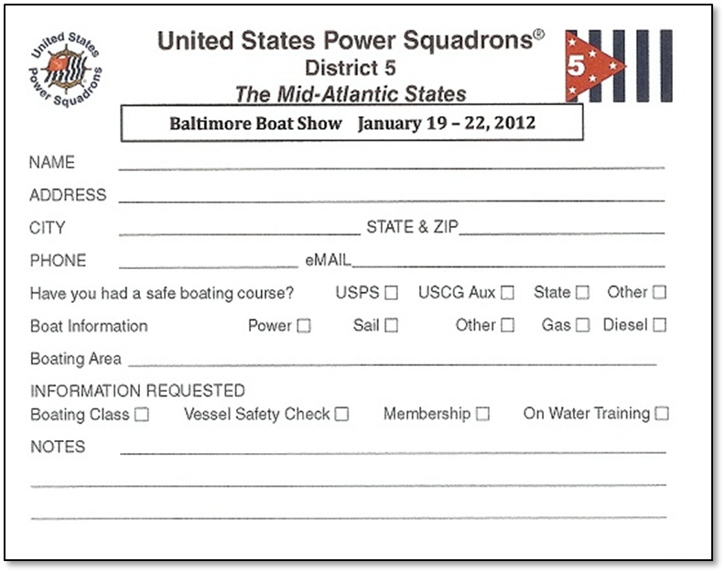
More on Personal Contact - Sales
Get their contact information and follow up.

Slide 54
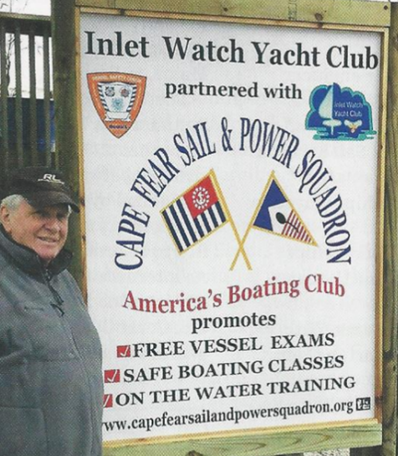
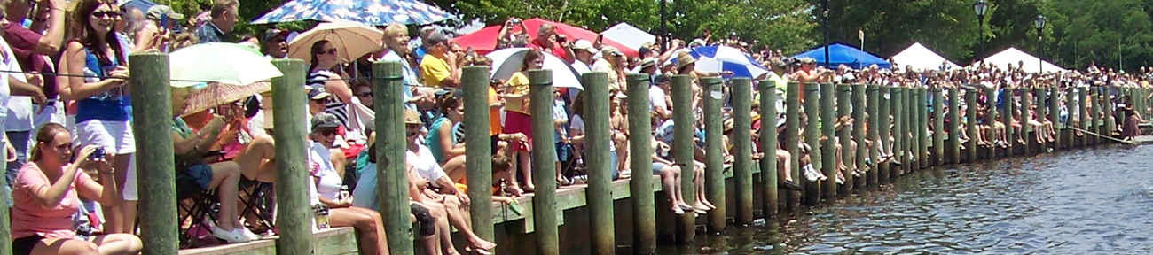
Partnerships, Public Events
(More PR and more ways to generate Personal Contact)
Partner with other boating organizations,
or community organizations and volunteer
to staff community events.
Not direct sales, but everyone you
encounter is a sales opportunity.

Slide 55
Distribution LABOR
Volunteers, Paid Help, and/or Donated Time
is required to distribute flyers, put up posters, staff events, build relationships, teach classes, do demonstrations, send out press, update web sites, keep social media active, make phone calls and much, much more.
You may need all 3 labor sources.

Slide 56
?
QUESTIONS

