Slide 1
Market Analysis and
Growing the USPS Brand
2016 Board of Governors Meeting
Pittsburgh, PA
Paul Mermelstein SN, Marketing Chair
Tammy Brown, HQ Marketing Director

Slide 2
Market and Self Assessment:
R+M Engagement
Phase I:
  Who are we? What do we want to be?
  Who do we serve? Who do we want to serve?
Phase II:
  What do we provide? What should we provide?
  How should we package it? How to deliver it?
Phase III:
  How do we communicate, internally and externally?
  How do we promote ourselves and offerings?
Notes:
We engaged the services of R+M Agency, a marketing and brand development firm, to work with USPS and help us chart a course from where we are to where we want to be. This phase has been completed.
Phase I was an important foundational and direction-setting initiative, aimed at answering the following questions [read]
Phase II, almost complete, focuses on our offerings and how to improve our portfolio. Among other topics, it aims at the following [read]
Phase III focuses on internal communication within USPS, external communication with the public and customers, and promotion. Phase III will be complete in a couple of months.

Slide 3
Who Are We: Our Personality
TRAITS | DESCRIPTORS
Knowledgeable | We love to learn, therefore we love to teach As a community that never stops learning, our strongest asset is the confidence we have in our boating education We are considered a resource on and off the water
Welcoming | We enjoy being part of a community on the water We enjoy sharing experiences and having fun with friends and family We have a network of volunteer members around the country
Passionate | We are dedicated to creating a safer experience for all to enjoy We face challenges together We strive to keep our membership motivated
Dependable | We are eager to help, and quick to react We promote our high standards and pledge to conduct ourselves with honor and with respect to others We are known for "doing it right"
Notes:
Most of us think we know who we are, but sometimes it takes a professional outsider to help us articulate it clearly and completely. The same thing is true for organizations. In our case, we worked with the consultants to define ourselves as follows:
[review chart, Read a Trait, then mention a couple of the illustrations. Then next trait, etc.]

Slide 4
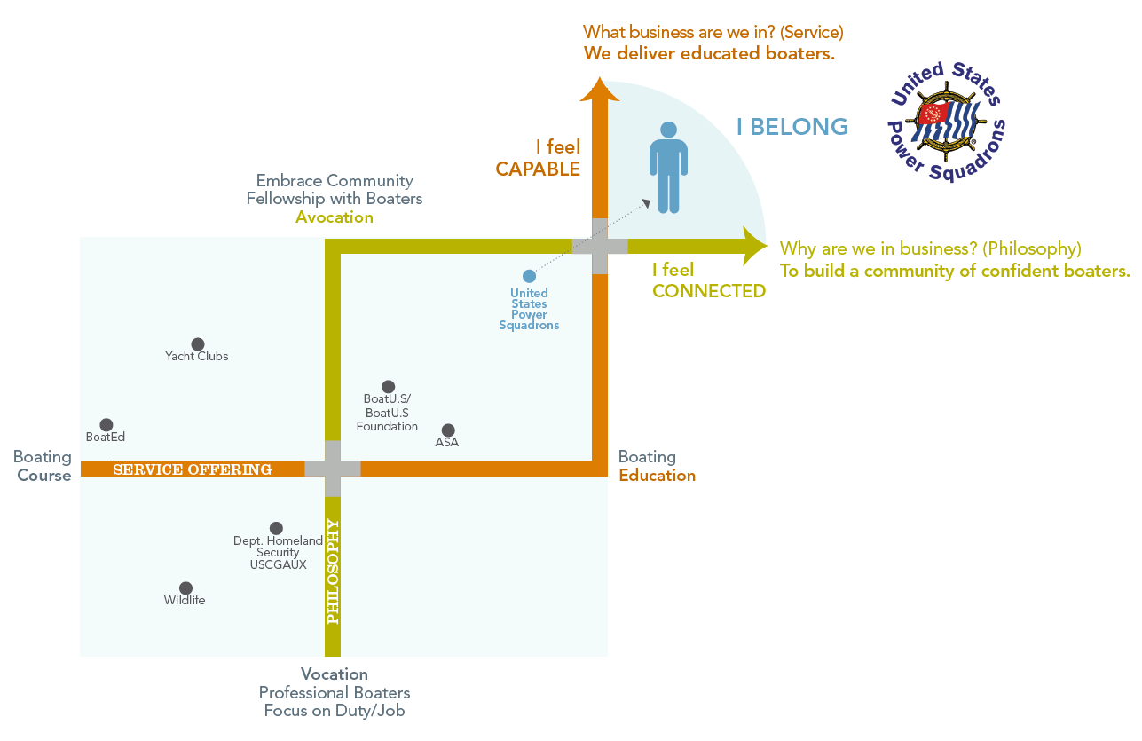
Positioning
USPS in marketplace
Education orientation
  Courses vs better boater
  Mandate vs mission
Participation orientation
  Required vs avocation
  Duty or job vs passion
Our focus
How members should feel
Notes:
The Positioning Analysis focuses on where we want USPS to be perceived relative to other boating educational organizations and boating clubs.
Part of the marketplace is Education:
Some organizations just focus on delivering a course, whether for revenue generation as a business, like BoatEd, or to meet a basic safety mandate, as in state-sponsored basic boating programs.
A few, like BoatUS and USPS, have a MISSION: creating better boaters.
Another comparison is the affiliation or participation orientation
Some participate because it is required, or job related, or their duty
Other organizations focus on the social aspect of boating, like yacht clubs.
USPS Focus: Few if any do both, like USPS. We stand out, and we do it right. But we have not communicated it well.
If we do it right, people will chose to affiliate with us they will feel:
Connected
Capable
That they belong

Slide 5


Our Audience
Outdoor Enthusiast
8.2 million boaters
Outdoor activities
Optimistic and fun
Escape from routine
Mid to upper class
Married, average age is 50
Volunteering: the environment and creating a better world
Education creates confidence on the water
Sociable Adventurers
7.3 million boaters
Adventure-seeking
Activities with family
Above average income
Married, average age is 47
About 40% have children at home
Volunteering: create memories with family
Education for the whole family
Notes:
[Review descriptions. Mention that we have two groups that we want to attract. Note that they are similar demographically, with one group focusing more on family activities, and the other looking at boating as an escape from the routine.]

Slide 6
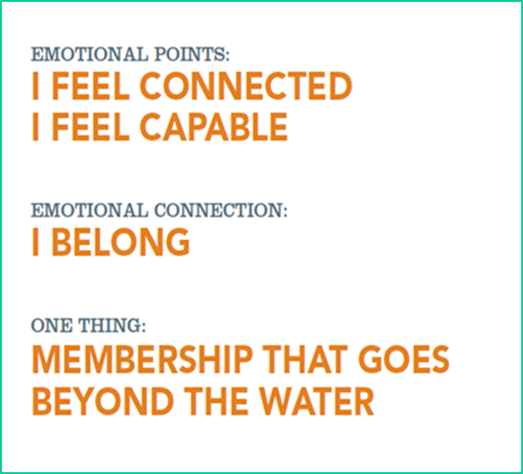
Demonstrating the Brand
OUR MESSAGE:
OUR BRAND:
As a United States Power Squadron member, you are more than a boater.
You belong to a community of confident boaters who love spending time together on and off the water.
Notes:
[First click]: We have an important message to convey. We have never described ourselves, and what membership means, like this before.
[Read “Our Message”]
We also want people to have a specific image of us in mind. This is our brand. Not just logos or tag lines, but a clear set of feelings and emotions associated with our name.
[read]
[pause, let it sink in]

Slide 7
Our Promise
We are more than your connection to the water.
We are your source for unsurpassed education, community service and your access to a membership
built by boaters, for boaters.
For more than a century we’ve been steadfast in the belief that an educated boater is a better boater, a safer boater.
We’ve kept our promise to continue learning, teaching, laughing and helping our fellow members enjoy boating.
We look forward to helping you build a lifetime of memories and welcome you to a membership that delivers beyond boating.
Notes:
Have everyone read aloud together.

Slide 8
Phase I Outcomes
Targeting portions of the boating public
Messaging and branding
Updating our appearance (wording, graphics, color palette, social media, website, etc.)
Imagery to demonstrate our brand, messages, and our promise
Notes:
So, here is where we are after Phase I.
[review]
However, now we need to get that message and image out there.

Slide 9
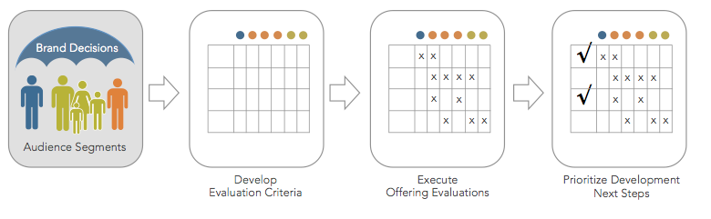
Phase II: All That We Offer
Educational / Volunteerism / Fellowship
Value to members and non-members?
What do we need to add / change / delete?
How should we package and offer it?
Notes:
We have a lot to offer in education, volunteering opportunities, and fellowship. So we evaluated all of our offerings in these categories.
We examined, and are examining, how each of our offerings adds value to our organization, our members, and to other customers and affiliates.
We may need to make some choices and changes. What do we need to add? What do we need to modify? What do we need to stop doing?
Furthermore, what kinds of combinations should we offer?
And how should we deliver education, volunteering, and fellowship?

Slide 10
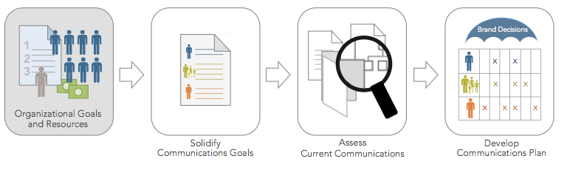
Phase III: Communication
Internal communication: between all levels and with all our members
External: to public for marketing, sales, recruiting
Based on our goals and values
Notes:
Phase III focuses on communication. Phase III has started and will be completed in the next couple of months.
Good internal communication helps the organization operate and can help coordinate activities and efforts for growth and development.
Internal communication with members can help members see the value of staying with the organization and even contributing to its success. Retention is part of membership stability, and some of that relies on communicating value and meaning of membership with each opportunity.
External communication with the public is essential to our development. External communication promotes our brand and image. It directly contributes to recruitment and to sales of educational programs. Effective marketing and promotion of our image, with the right messages, is essential to organizational success.
So, we are looking at what we communicate, how we communicate, media used, how frequently, and so on.
But for some things, we don’t need to wait, as we will see next.

Slide 11
Presence in the Marketplace
Problem:
Image:
Challenge:
Objective:
Familiarity & name recognition
What do people think of us?
Create a positive, clearly recognized identity
Generate desire to know more about USPS
Notes:
We have a problem. People don’t know who we really are.
Our image is either non-existent, or murky, or down-right incorrect. For example:
Some people think we and the CG Auxiliary are the same
Some people say: “Yeah, I took their basic boating course. You’re the basic boating people”
Many boaters have heard our name, but don’t know much about us.
So, what we need to do is establish, or re-establish, our identity using the imaging discussed previously.
Furthermore, we want people to want to know more; to get to know us.

Slide 12
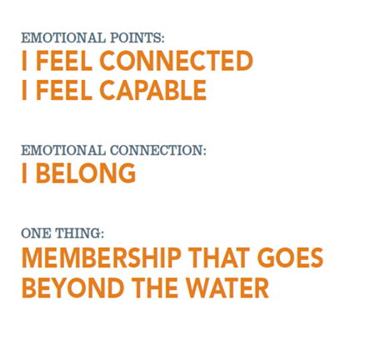
USPS Brand Development Ad
Visually connects to our message
Conveys excitement
Gets attention
Provides information
Appeals to both emotion and reason
Notes:
So, we need to pursue an advertising campaign and are working toward that end.
Remember that we need to convey the right messages, and that those messages need to induce a positive and emotional reaction to our brand. When people think of us, we want them to feel a connection to us, that they belong.
Furthermore, we want to sense that when they belong, they also will feel capable on the water.
So, we need to generate messages and feelings, along with excitement that gets their attention.
Furthermore, we need to generate interest by backing up those feelings with information about what’s in it for them, by associating with us. That information should leave them wanting to find out more.
Consequently, we have been working on an ad that we believe will appeal to both emotion and reason.

Slide 13
The Photo Shoot
Kudos to
  P/D/C Marty Lafferty
  D/C Randy Stowe
  Cdr David Eberle
  All the members of Smith Mountain Lake squadron
Professional photographer
Professional graphic artist
Close coordination with R+M
Notes:
[review]

Slide 14
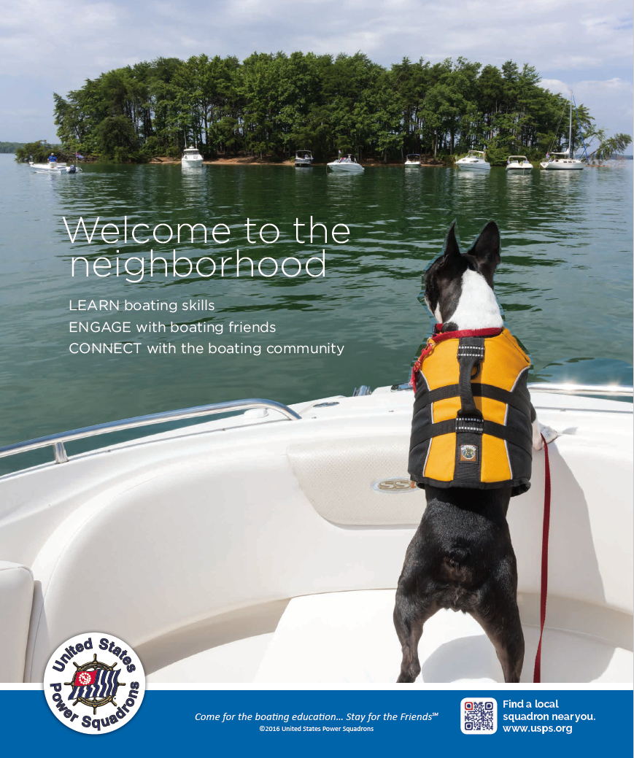
USPS Brand Development Ad
Excitement/Anticipation
Welcoming/Inviting
Benefits to viewer
  Learn
  Engage
  Connect
Raises interest
Name recognition
And yes, she’s wearing her life vest!
Notes:
[BEFORE THE FIRST CLICK:]
This ad is very different from what we have done in the past. Instead of asking the customer to focus on boating safety, or trying to impress them with our 100 year age, we need to generate excitement, show that we are welcoming and would happily include them in our organization, and let them know in just a couple of nano-seconds what we are all about.
[click: the reveal]
Notice the welcoming message. Notice the excitement and anticipation. Note the brief but succinct description of what’s in it for the potential member.
Learn boating skills
Engage with boating friends
Connect with the boating community

Slide 15
Upcoming Plans
Seamanship email campaign
  Non-member emails from prior encounters
  Beta test in D15 & D22 now
ABC ad campaign
  Dual goals: Sales and new members
  Both online and classroom delivery
  Collaboration with districts & squadrons
  Seeking funding
Notes:
In addition to the ad discussed so far, we are embarking on an email campaign for promote Seamanship as the next important step for boating education students. Here, we are focusing on non-members for now, who have taken ABC3 or a seminar from USPS. First a beta test, and then national roll-out.
We also are pursuing a campaign for ABC. Note that it is not just online sales, but also aimed at squadron-based education with an intent to promote membership. Both promotion and delivery will need to be coordinated with squadrons and districts. The program will also include guidance to squadrons to help them convert students to members. Next steps are to create a plan and proposal for funding the campaign.

Slide 16
Squadron Support - Available NOW!
Guidance for all squadron officers
  Promoting the squadron
  Recruiting members
  Education programs on Marketing
Marketing materials
  Tri-fold brochure
  10 slide PowerPoint presentation
All downloadable from MARCOM page
Notes:
As part of our squadron support, Marketing has visited squadrons and talked with them over the phone and email. We have produced a large amount of material to help squadrons with recruiting and marketing their courses and seminars. These materials range from instruction and guidance, to marketing collateral they can use directly. We continue to add material to our committee web page.

Slide 17
Thank You
Your Marketing Team
Contacts:
R/C Paul Mermelstein, SN
pmermelstein@verizon.net
Tammy Brown
brownt@hq.usps.org

